Slide 1
Queen Mary
Academy
Learner Engagement Analytics (LEA)
Dr. Christine Couper (Learning Analytics Consultant)
Graeme Hathaway (Innovation and Learning Manager)

Slide 2
LEA Workshop Plan
Welcome
What is Learning Engagement Analytics (LEA)?
What does Queen Mary means by LEA?
Tactical recommendations for 2021-22
Outcome from the World Café Review
Governance
QEngage 4 – personas
Maximising data quality
Research – Community of Practice
Next steps
Interventions – a discussion led by a member of staff from the School–focus
Development of a new Strategy
LEA
Notes:
Paste Mentimeter link into chat whilst introducing this slide to allow those that want to start to do so.

Slide 3
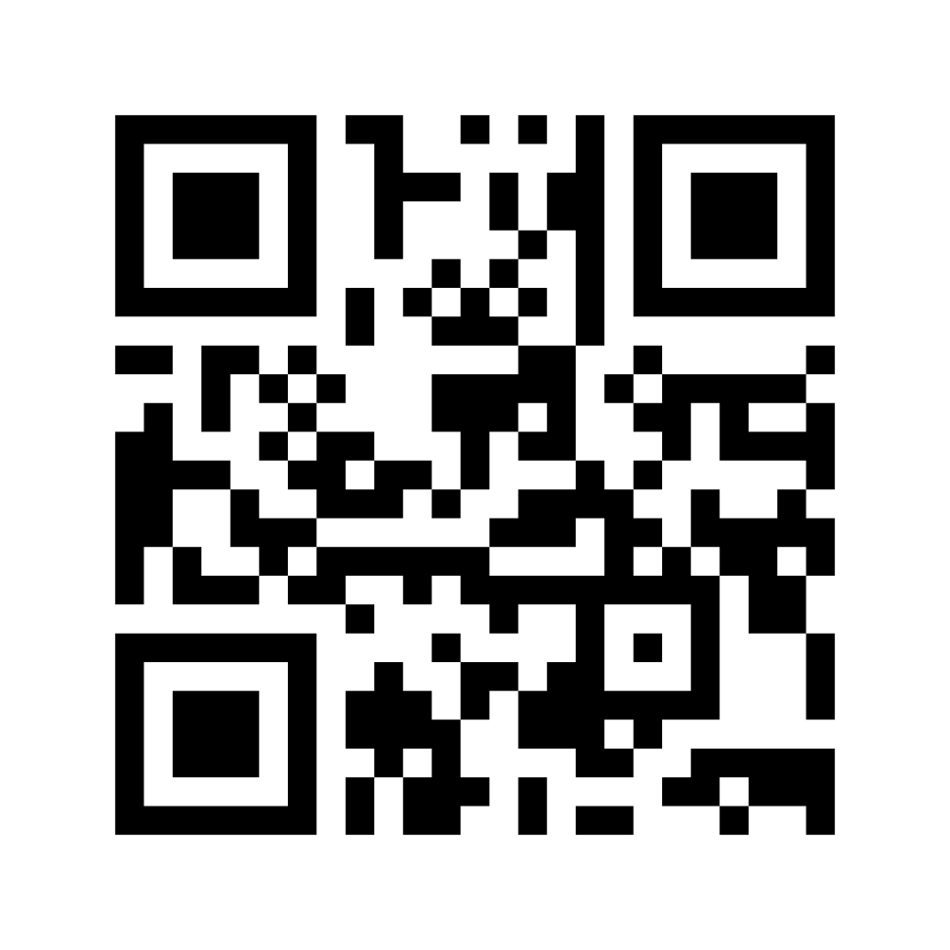
Q: With regard to QEngage 4, which role at QMUL are you most interested in hearing about? The Advisor or a Module Lead?
Please log in to the Mentimeter check and type in your job title – let’s see who is here!
On your device, please access the following link or scan the QR code to input your answer.
https://www.menti.com/e1akj3w2ds
Or go to www.menti.com and use the code: 1206 4498
LEA
Notes:
Paste mentimeter link into chat and switch to Mentimeter wordcloud to visualise who is in the session. Switch back to the presentation when ready.

Slide 4
What is Learner Engagement Analytics (LEA)?
Learner Engagement Analytics (LEA) is concerned with combining different types of data regarding student engagement and learning (e.g. data generated by learning management systems, student systems, library systems and other sources related to learning and teaching) in order to better understand, and take action to improve, the learning experiences of our students.
Short introductory video (2.54 min)
https://www.youtube.com/watch?v=XscUZ8dIa-8
"Precision education requires two equally important conditions: accurate predictions of academic performance based on early observations of the learning process and the availability of relevant educational intervention options" (Tempelaar, D., Rienties, B., & Nguyen, Q., 2021).
LEA
Notes:
Share video link in the chat. Also share screen of video playing – remember to share computer audio. Switch back to the presentation when ready.

Slide 5
What does Queen Mary mean by LEA?
What we did
Tactic Review.
World Café.
Focus Groups.
1:1 meetings.
What we found out
Tactical review outcomes.
World café outcomes.
LEA

Slide 6
Tactical Recommendations for 2021-22
Introduce a Governance Framework.
Simplify access to QEngage - Introduction of Personas.
Greater focus on QMPlus data.
Review of module setup to optimise data quality.
Link between LEA data and interventions tailored to each School.
More communications and training about LEA.
LEA

Slide 7
Outcome from World Café review
The four separate analyses of the Padlet data generated outcomes that were very similar which provides a level of confidence to what was a subjective set of analyses.
In answer to the question “How should we use Learner Analytics (LA) in the future?” there are some key findings:
Benefits for students must have primacy.
While a key focus should be on monitoring student performance, this must be done openly and transparently with students and educators as partners in the learning journey.
Interventions must be available to ensure students are fully supported.
As discussed - LA data may be used to inform classroom practice and curriculum design.
Governance and ethics must be used to create a secure framework within which this work takes place. Communications and training for staff and students will be important.
Measures of success may be nuanced. While a key goal will be improvements in KPIs, the focus should be on enhancing the student journey, embedding university values and driving a change in culture.
LEA

Slide 8
Governance - Statement of Principles
We will use Learner Analytics to help all students reach their full academic potential.
We will be transparent about data collection, sharing, consent and responsibilities.
We will abide by ethical principles and align with our university strategy, policies and values.
Learner Analytics will be supported by focused staff and student development activities.
Learner Analytics will not be used to inform significant action at an individual level without human intervention.
We will actively work to recognise and address any potential negative impacts from Learner Analytics.
LEA

Slide 9
Governance - Purpose of Learner Analytics (1)
We will use Learner Analytics for the purposes listed below. We will not use Learner Analytics for any other purpose without formal review of the Learner Analytics Governance Documents.
Quality of Education
As a form of feedback on the efficacy of pedagogical design.
Analytics about student activity (individual or cohort) can form part of course review and re-design processes and of in-course monitoring and feedback.
Individual staff can use Learner Analytics to reflect on the impact of their teaching.
Inclusion
To provide more nuanced views of our highly diverse student population, challenge assumptions that we may be making, and allow supportive resource to be directed where it is most needed.
Personalised feedback
To tailor the messages and support we offer to our students, providing more personalised feedback to support student reflection and academic planning.
LEA

Slide 10
Governance - Purpose of Learner Analytics (2)
Coping with scale
As part of an enhanced staff engagement programme, Learner Analytics can help strengthen the academic relationship by doing some of the heavy lifting of identifying individuals or groups of individuals that might benefit from particular interventions or information from staff.
Student Experience
To improve progression and retention, ensure that our academic offerings align with the needs and goals of students, support satisfaction and wellbeing, and engender a more personalised learning experience.
To promote critical reflection skills and enable our students to take responsibility for their own learning.
LEA

Slide 11
Governance - Purpose of Learner Analytics (3)
Skills
Interactions with Learner Analytics as part of the university learning experience can help our students build 'digital savviness' and prompt more critical reflection on how data about them is being used more generally, what consent might actually mean and how algorithms work across datasets to define and profile individuals.
Learner Analytics approaches can also be used to promote the development of key employability skills.
Supporting staff to develop skills in working with Learner Analytics applications is also an investment in institutional capacity and leadership.
Efficiency
Learner Analytics can be used to evaluate and demonstrate institutional efficiency through:
(a) measuring the impact of initiatives and validating that benefits are being realised and
(b) demonstrating that publicly funded resource is being deployed in support of the best outcomes of all students.
LEA

Slide 12
QEngage 4 – two personas released
Released
Advisor
Module Lead
Student Support Officers (SSOs) will be able to use the Advisor persona
To be released during Semester 2
Programme Lead/ Director of Education/ Head of School.
Student Dashboard – as a Beta Test
LEA

Slide 13
Select the Advisor Persona
LEA
Notes:
Advisor screenshots: slides 13-19
Module lead screenshots: slides 20-24

Slide 14
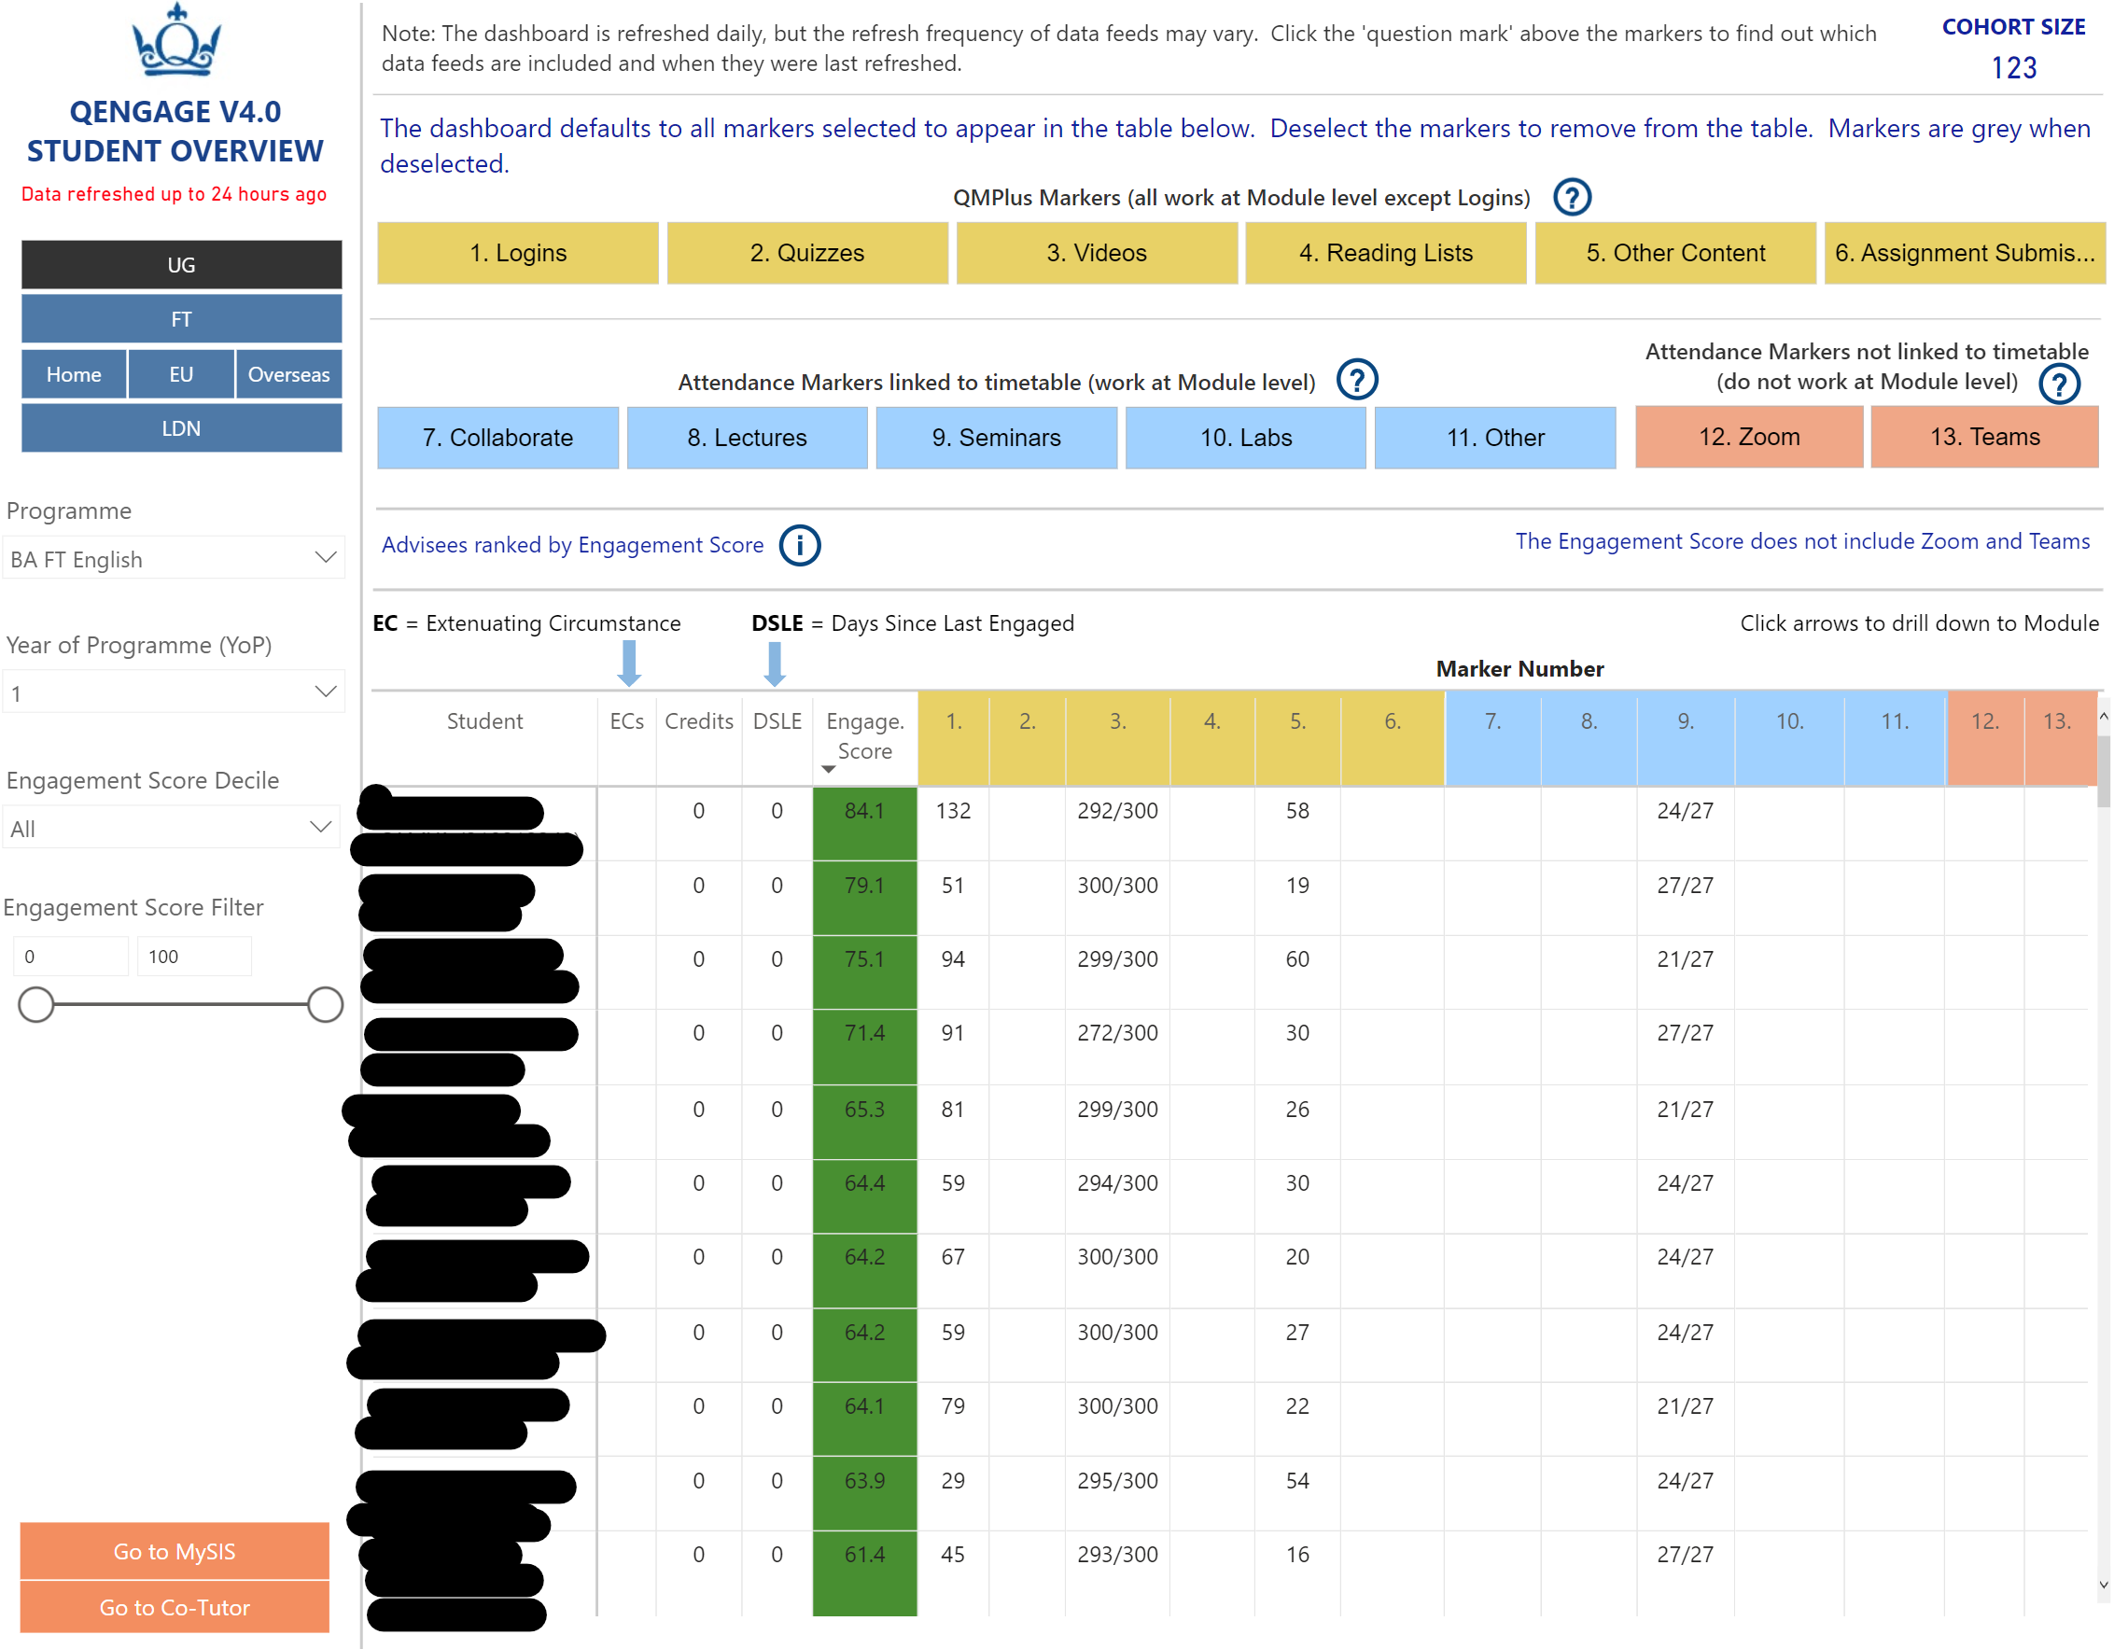
Student Overview
LEA

Slide 15
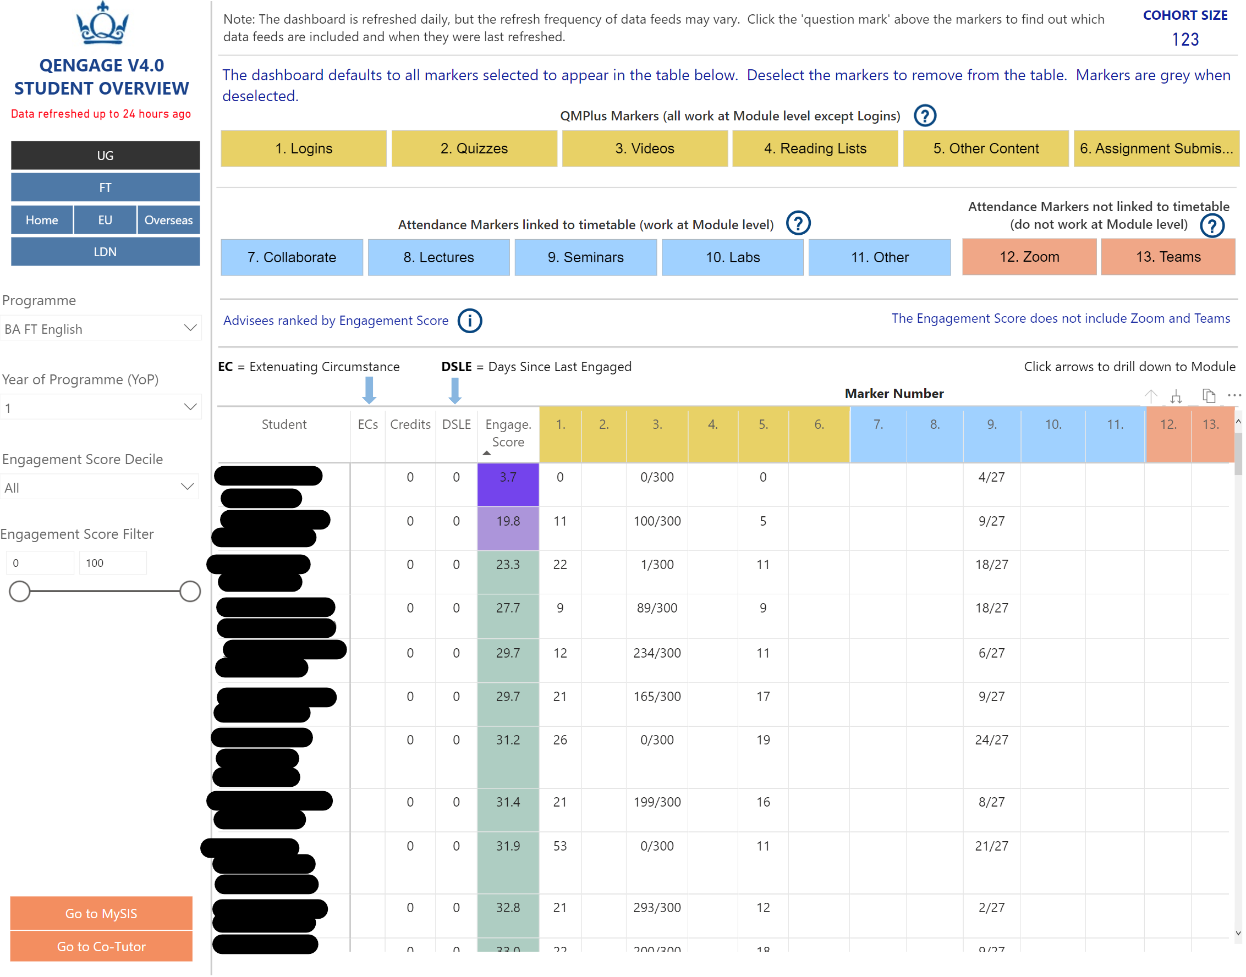
Student Overview
LEA

Slide 16
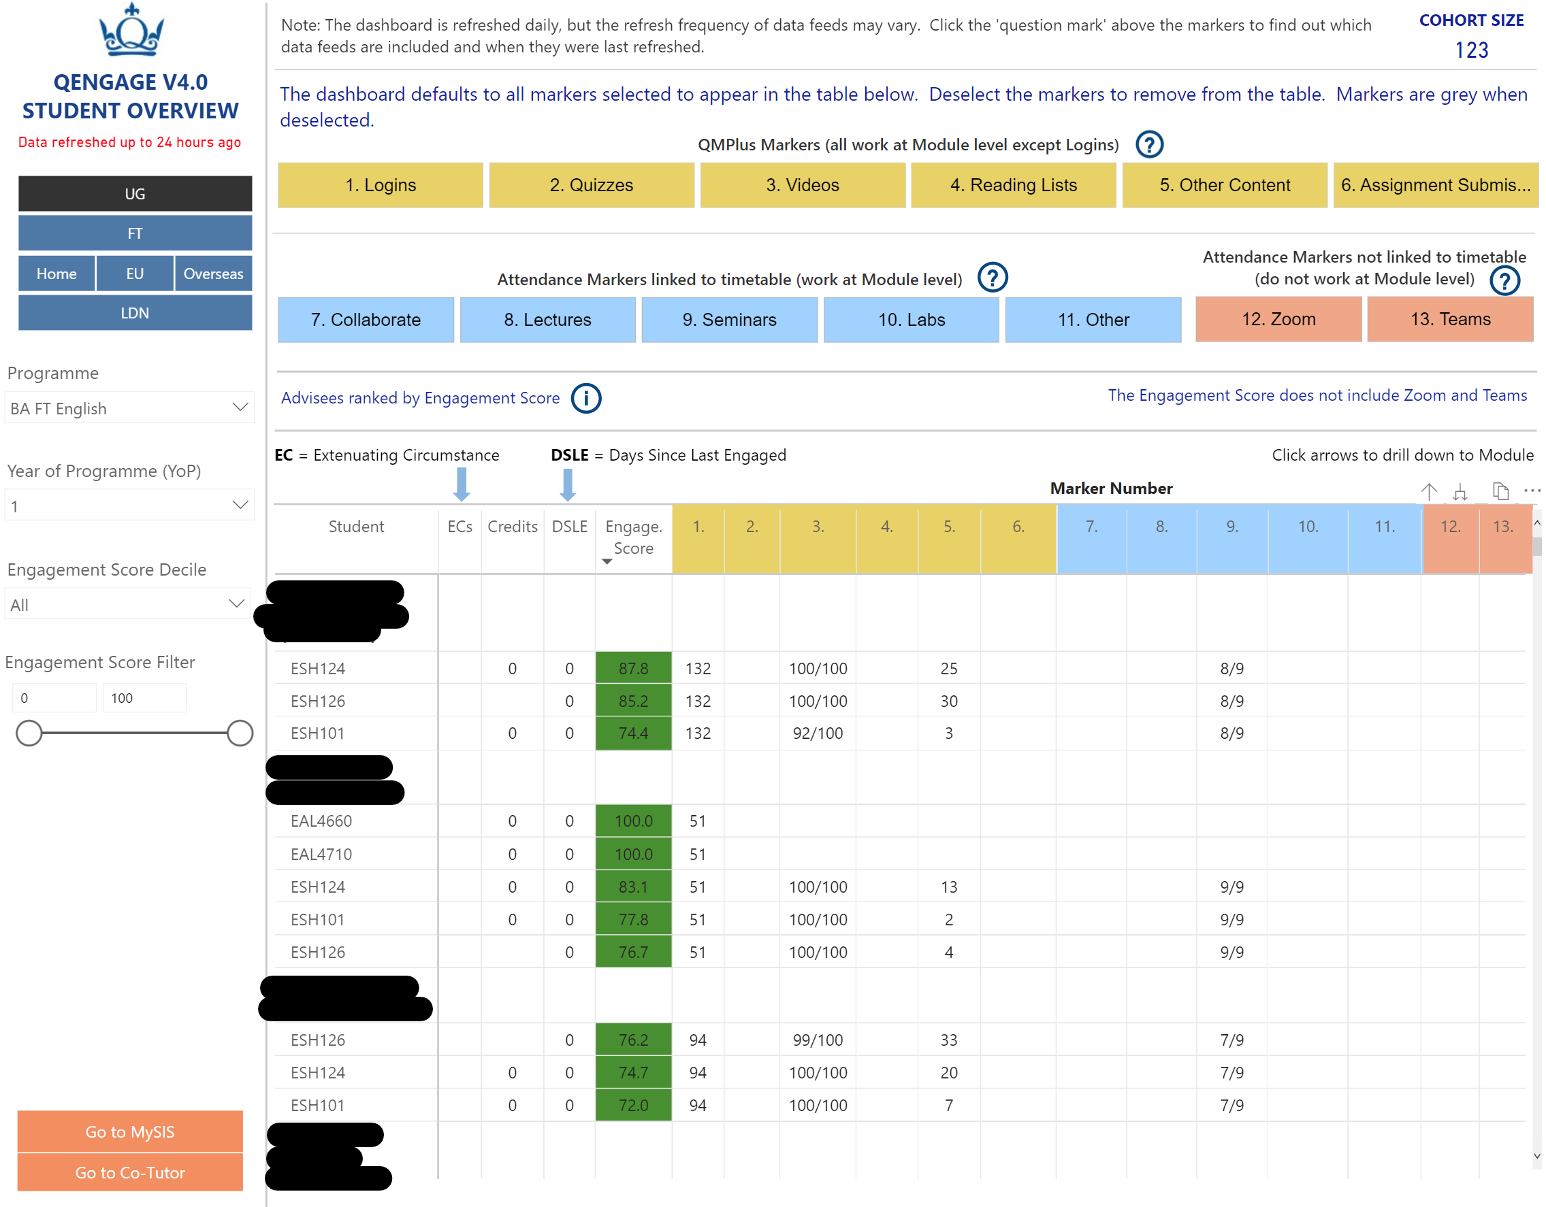
Student Overview – with drill down
LEA

Slide 17
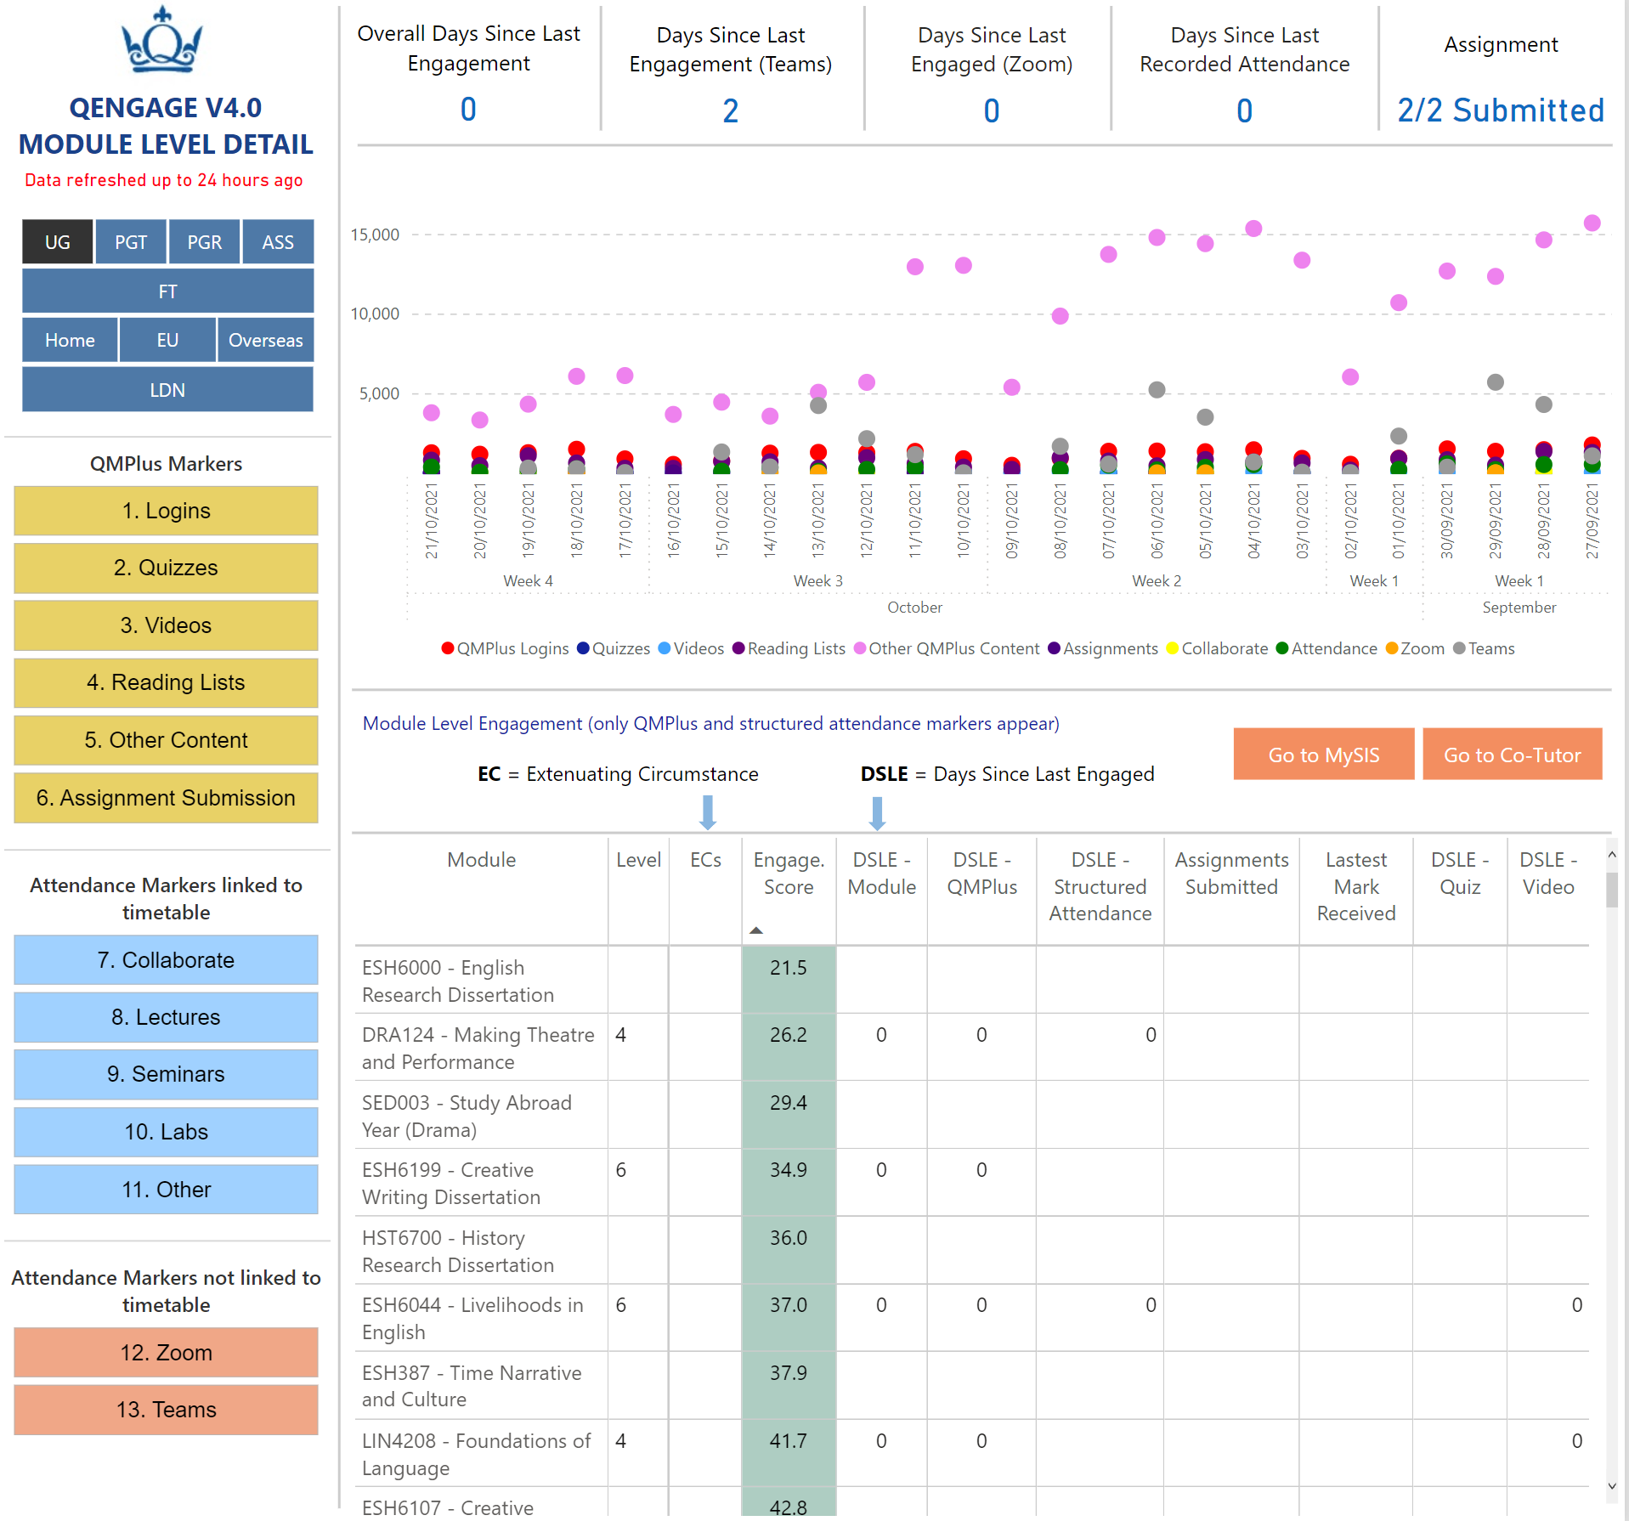
Module Level Detail
LEA

Slide 18
Select the Module Lead Persona
LEA

Slide 19
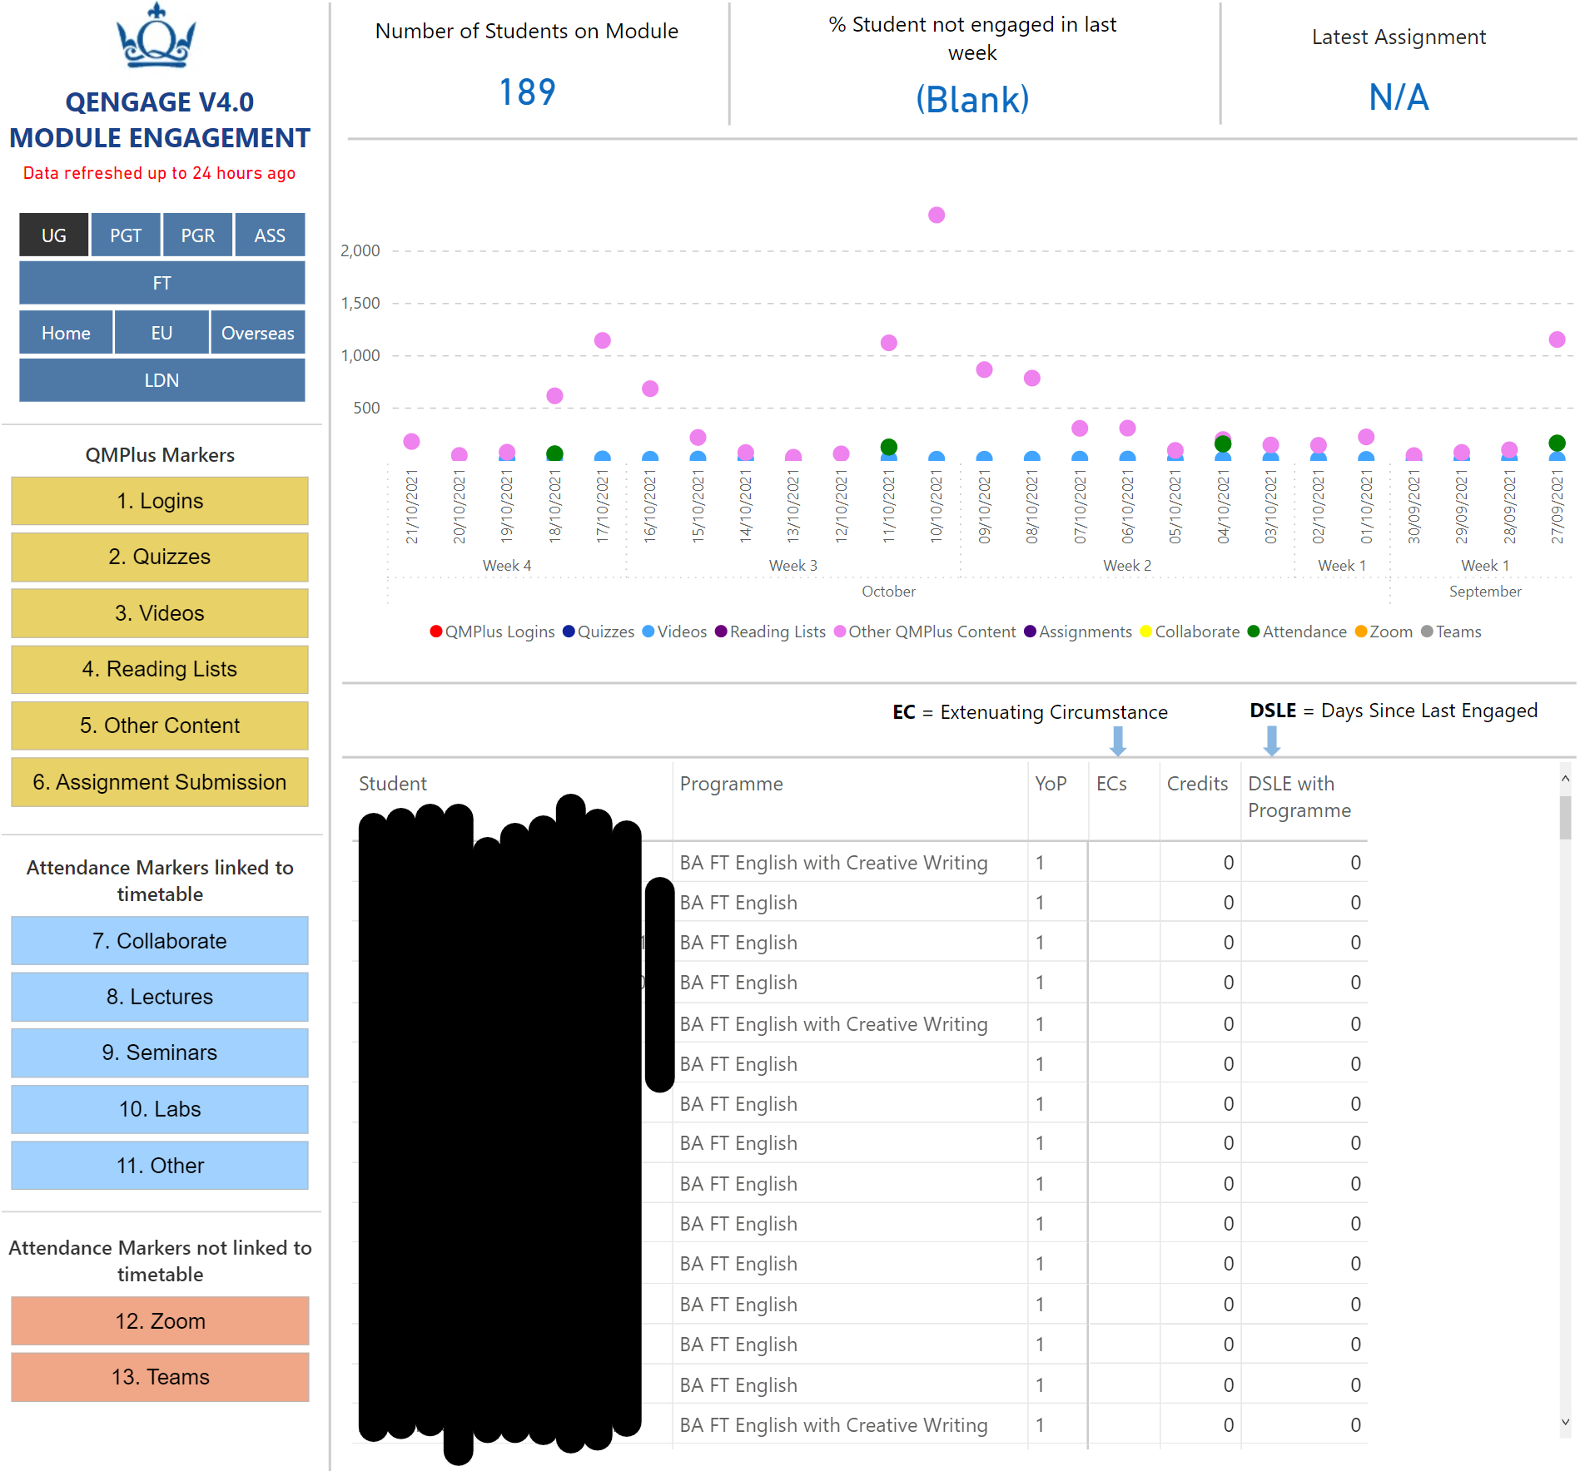
QMPlus Module Overview
LEA

Slide 20
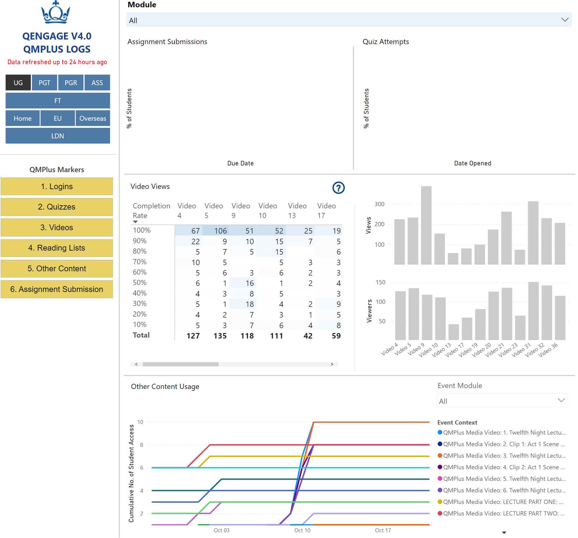
QMPlus Markers
LEA

Slide 21
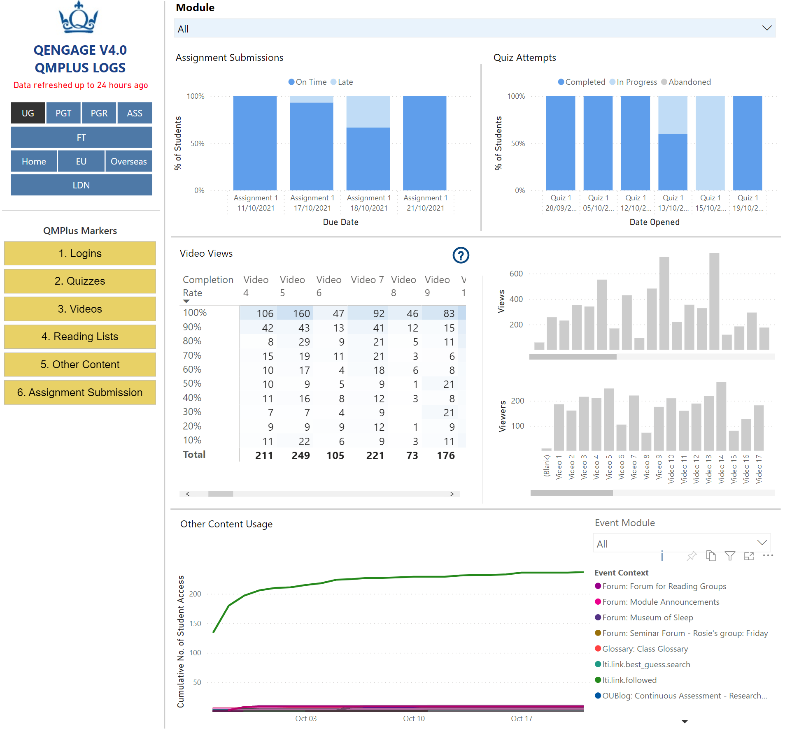
QMPlus Markers
LEA

Slide 22
 |  | Set Up Guidance | Issues with data
QM Plus Markers | QM Plus Logins | N/A | N/A
 | Quiz Participation | Use QMPlus Quizzes (https://elearning.qmul.ac.uk/guide/how-to-create-manage-a-quiz/) not H5P or other activities such as SCORM. Please add the full title (Not just short title) when setting up quizzes, if you would like to view meaningful information in QEngage | Only quizzes set up as recommended in the 'Set Up Guidance' are included in the quiz 'Marker' analysis in QEngage.
 | Video Usage | Move/Store videos and recordings to QMplus Media (Kaltura) and make them available via QMplus don't leave them on Zoom (QMplus media is integrated with Zoom, so all Cloud recordings are automatically transferred to your QMplus account), Collaborate or Teams. You can also manually upload videos to QMPlus Media using this guide - https://elearning.qmul.ac.uk/guide/uploading-a-video-to-your-my-media-area/ Q-Review- make you Q-Review recordings available via QMPlus (not via public links, emails, or embedding them on a website) | Q-Review lecture capture recordings set up to allow anonymous access are not included in QEngage, because the user cannot be identified
 | Reading List | Use Talis Aspire for Reading lists and make your list available via QMplus | Information about students interactions with their Aspire reading lists is taken directly from Talis. Therefore, only users who have logged in using their Queen Mary username and password, prior to accessing reading lists, are included in QEngage
 | Other Content Usage | N/A | N/A
 | Assignment Submission | Please add the full title when setting up assignments, if you would like to view meaningful information in QEngage. In order to enable the accurate reporting of assignment submission QEngage, it is essential that strict numbering conventions are observed for both on-time and late assignment submission, and associates and non-associates submission points in QMPlus. Please refer the instruction below on how to set up assignments. Add Module Code in the ID Field (within Common Module settings) while setting up assignments. Here is the link to the guide (step 9 explains how to populate the ID field) - https://elearning.qmul.ac.uk/guide/creating-a-standard-qmplus-assignment/ | QEngage can only accurately report on submissions due, late submissions, associates and non-associates submission points, if the assignment is set up as indicated in the 'Set Up Guidance'.
Attendance linked to timetable | Lecture | QEngage is set up to report on attendance from the following systems: 1. Attendance Entry app (online register) which is linked to the student timetables 2. Handheld barcode scanners 3. Wall scanners in large lecture theatres 4. E-Clio (School of History’s) online register | The Attendance Entry app method of recording attendance, requires schools to set up their timetables in SCIENTIA and populate the relevant activities with the Tutor/TA’s email, so that he/she will be able to access their registers when they log in to the ‘Attendance Entry’ app.
 | Lab
 | Seminar
 | Other Attendance
Attendance not linked to timetable | Zoom | In order for Zoom attendance to be reported at a module level, Zoom activities must be set up to match the SCIENTIA timetable. This means that the start date and time for the Zoom activity must match the student's timetable. QEngage will match the date and time that the student joined the Zoom activity, to their timetable to determine which module the activity was for. | Many Zoom activities do not match the student's timetable. Therefore, QEngage is only reporting on engagement where the student participates in a meeting or webinar that matches their timetable.
 | MS Teams | It is not currently possible to set up Teams activity in such a way as it can be linked back to the timetable | The current usage logs provided by MS Teams data access interface, only provide data on the number of meetings per student. Therefore, we are unable to determine for which module a student attended a meeting
 | Collaborate | Attendance at Collaborate sessions is taken directly from Blackboard.
Maximising data quality
For further information on using the digital tools that maximise data quality contact the QMUL E-Learning Unit:
https://elearning.qmul.ac.uk/qengage-and-learners-analytics/
elearning@qmul.ac.uk
LEA

Slide 23
Research – Community of Practice
What actions are being taken to better support students?
What are the measures of success?
What have we learned?
How can the insights be shared?
What actions can be taken to enhance the curriculum?
What other research questions could we ask?
Using data science models?
Collecting data that identifies the interactions between staff and students using on-line resources – e.g. blogs.
What are the challenges and how could they be resolved?
LEA

Slide 24
Next steps
Attendance monitoring.
Improving data quality.
Research into which patterns that might indicate lower engagement.
Research into interventions that work.
Community of Practice – sharing good practice, research and resources.
Review of commercially available software.
Review of possible additional datasets.
LEA

Slide 25
Interventions – a School led discussion
How LEA visualisations align and support the practice, procedures, values and norms of supporting students in the School.
How LEA can be rolled out most effectively within the School.
LEA

Slide 26
Development of a new Strategy
Roll-out timeline.
Methodology to monitor the impact of LA in terms of student engagement , retention and success.
Inclusion of LEA curriculum engagement data in pedagogic review.
LEA

