Slide 1
Working during study
Careers & Enterprise
Notes:
Working in the UK Advice on working part-time & during vacation
What careers does at QM
Next time – video of WG3, mention skype appointments
LInkediN good way to build network
More examples of skills based work – PAID e.g. indeed
Funny jobs slides
NB tutoring not self-employed
Show events page
Reference jet lag

Slide 2
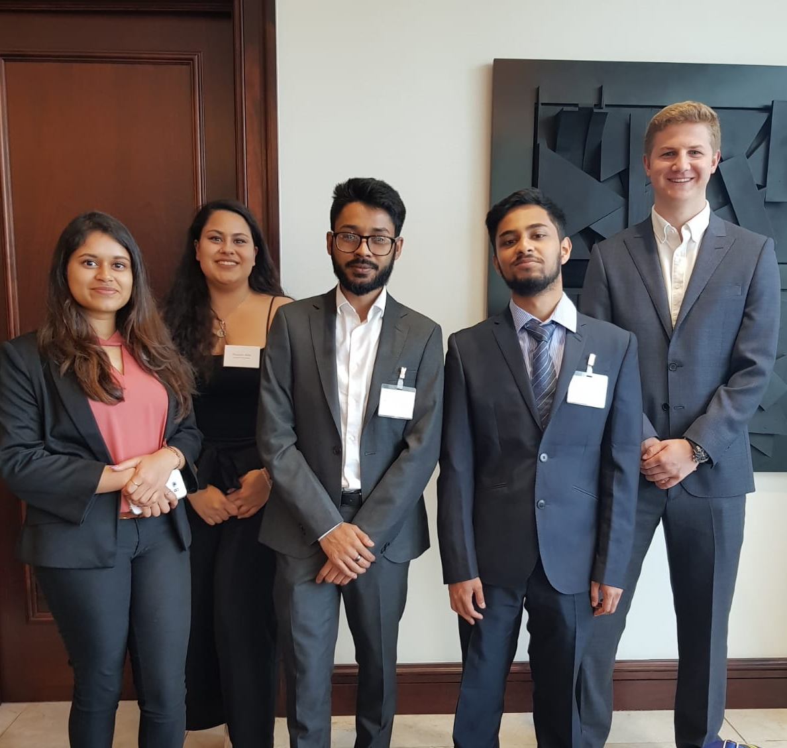
How do I find work opportunities?
https://q-temps.co.uk/
https://qmul.targetconnect.net/leap/jobs.html
http://www.careers.qmul.ac.uk/students/workexperience/
https://www.qmsu.org/jobs/
Undergrads:Apply for QConsult or SBM QConsult
http://www.careers.qmul.ac.uk/qconsult
Notes:
Model these sites
Take a photo of slide!

Slide 3
Events coming up!
Business & Finance Fair
- Monday 7 October
STEM Fair
- 28 & 29 October

Slide 4
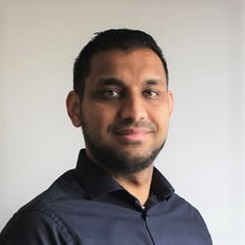
Booking a Careers appointment
Call the QM Careers & Enterprise on
0207 882 8533
or visit us in WG3, near The Octagon, Queens Building to book a 20 minute appointment
Appointments can cover any careers query, including:
- CV & application feedback
- Finding and applying for work experience, part-time work or graduate jobs
- Deciding what to do after graduation
- Practice interviews
- Starting your own business

Slide 5
Internships & graduate roles with larger employers
Advertised internships in large organisations are usually:
Full-time (35h per week) for at least six weeks, sometimes up to three months during the summer
Applications open in the summer of the year before and close by December
Competition is intense – usually tough video interviews and numerical and verbal reasoning tests as the first part of the selection
START EARLY!!
The main websites are:
www.targetjobs.co.uk
www.milkround.com
www.insidecareers.co.uk
www.gradcracker.com
Notes:
This means that:
Masters students will not usually be able to apply to these
For undergraduate students, doing an internship such as these might not be compatible with taking a summer holiday
To get these kind of internships you will need to decide now and apply in the next month or so.

Slide 6
How can Careers & Enterprise help you?
What we DO
Advise on how you can find part time and full time work, work experience or internships
Support you in writing job applications, CVs and preparing for interviews, through workshops and short appointments with a careers adviser
List part time and full time vacancies on QM JobOnline.
Help you choose a career which suits you through discussion with a careers adviser in a short appointment
Organise events through which you can meet employers and find out about different careers in and outside the UK. They come onto campus but they don’t recruit (at a fair/event)
What we DON’T DO
Recommend or introduce you to an employer
Provide lists of all the employers recruiting people from your country or your degree subject
Proofread your CV/ application form for spelling and grammatical errors. - use QM in-sessional English courses
Give detailed advice about your entitlement to work in the UK: see Advice and Counselling
Run interviews with employers on campus

Slide 7
UK CV Format
Name
Contact details – UK number
Qualifications
Work experience
Extra curricular activities
Tailor your CV for each role
See our template in the Career Guide
Photo
Date of Birth
Marital Status
More than 2 pages
Colour, borders & shading – keep it simple

Slide 8
Questions?

