Slide 1
Reading and note-making for exams

Slide 2
Learning Outcomes
Understand the importance of being selective in what you read for revision.
Reflect on why we make notes as part of reading and revision
Apply strategies to make your note-making more effective

Slide 3
What is useful to read?
Reading is usually the most time-consuming aspect of exam prep. So it’s important to do it selectively.
Generally, you should be reading to consolidate knowledge and fill-in small gaps.
Useful readings include: lecture notes, textbook excerpts, encyclopedia articles on topics that will come up in your exam and review articles in journals.
These are useful formats because they are information-dense and tend to cover broad aspects of a subject quite succinctly.

Slide 4
What is less useful to read?
It’s generally not advisable to spend lots of time reading new material. A journal article might give you lots of detailed information that might be relevant to your exam.
But it will also:
Include information that isn’t directly relevant.
Include more detail than you’ll need on the method and findings of this particular study.
Only cover one perspective on the subject.

Slide 5
Be selective
Of course, the more you’re able to read for your exams, the better.
But you only have a limited amount of time to revise for each exam. So...
Plan your time.
Be selective in what you read.
Focus on the quality rather than quantity.
Make sure you’re making effective notes.

Slide 6
Tips: Making notes as you read
Don’t underline or highlight everything.
Think about why you are making each note. Will it help you to revise later?
You want your notes to condense the most useful parts of the thing your reading.
Write potential exam questions at the top of the page.

Slide 7
Tips: Making notes as you read
It’s often better to paraphrase information than to quote.
If you do copy out something verbatim from the text, put it in quotation marks and put a page reference in the margin.
Write down your own observations in your own voice, rather copying the style of the author
This will help you to write about your subject later on.

Slide 8
Why we make notes
Reinforce key terms.
Record basic factual information.
Make note of an author’s argument.
Write the pros and cons of their argument.
Note connections with other things you’ve read.
Flag questions you have about a text.
Write down what you think so you’re prepared to answer an essay question in your own words.

Slide 9
Note-making, not note-taking
Notice how we use the term note-making rather than note-taking?
Note-taking implies that you are doing something passive, like taking dictation.
Note-making recognises that you are doing something creative that requires you to use critical thinking and apply understanding you’ve gained from your course.

Slide 10
Reading notes: an example
Heading with course/author info makes notes easier to organise
Page numbers allow you to go back and check references
Key points of author’s argument set out clearly in quotes and with initials
Key facts recorded
Questions you need to follow up on flagged in different colour
Reader’s reflections are recorded in own voice
Notes connections to other concepts/readings

Slide 11
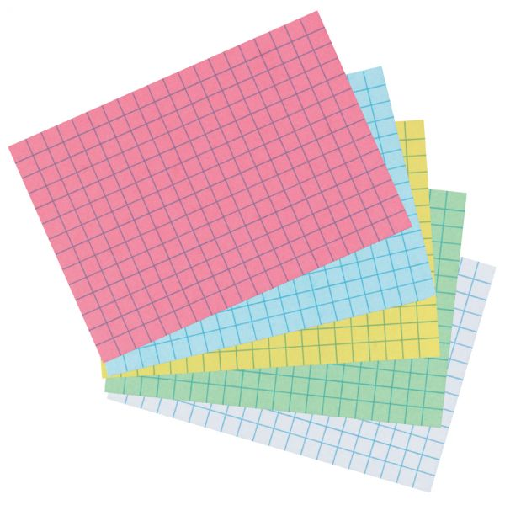
Condense your notes
Effective note-making can reduce the amount you have to read.
If you can condense your notes on a chapter of a textbook to two sides of A4, you’ll be able to revise that topic without going back to read the whole chapter.
If you condense them again onto an index card, you’ll be able to revise them even more quickly.
And the act of condensing your notes will reinforce your knowledge of the topic.

Slide 12
More tips:
To find more resources, access workshops and one-to-one support, visit: http://qmul.ac.uk/library/academic-skills

Slide 13
End slide

