Slide 1
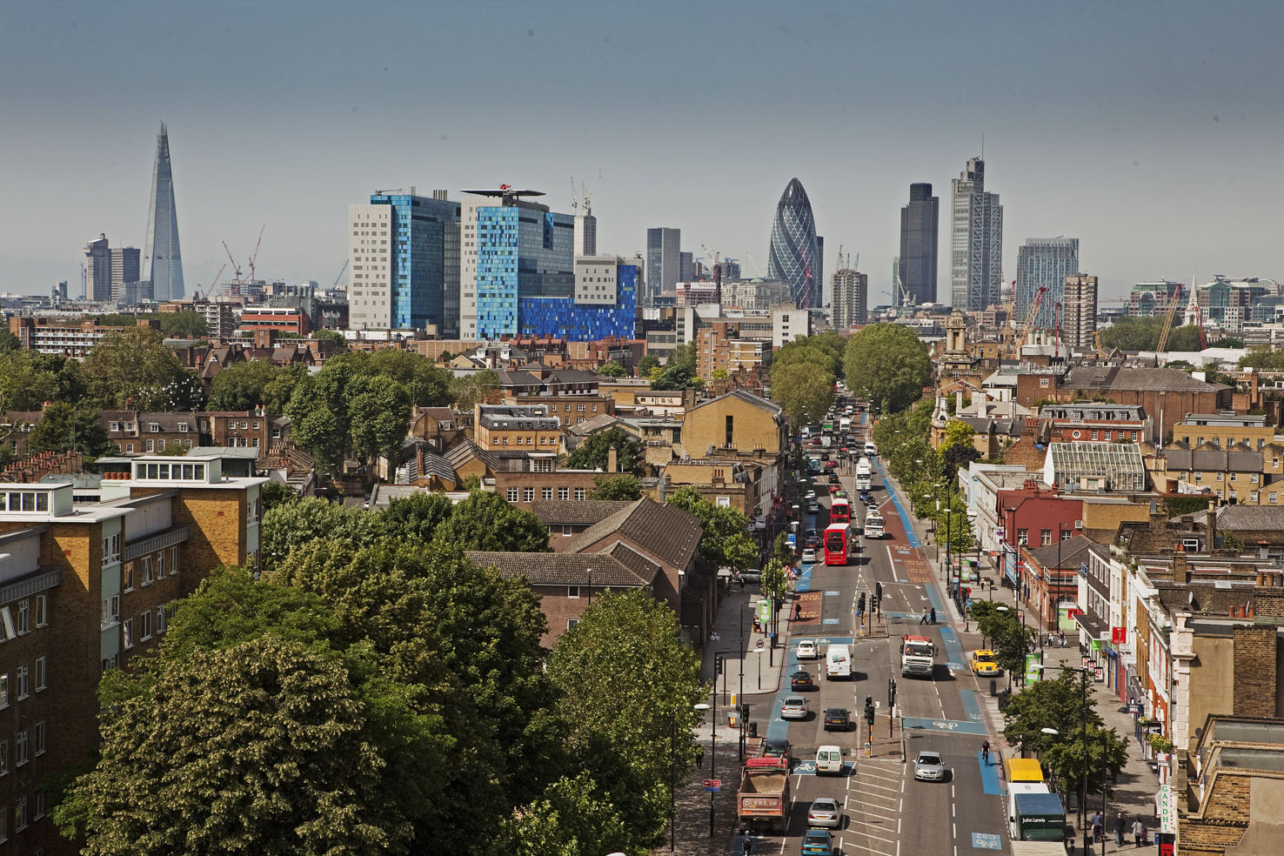




Changing Places
Field Study Course for Teachers, Wednesday 16 March 2016
Kate Amis
Alastair Owens
Stephen Taylor

Slide 2
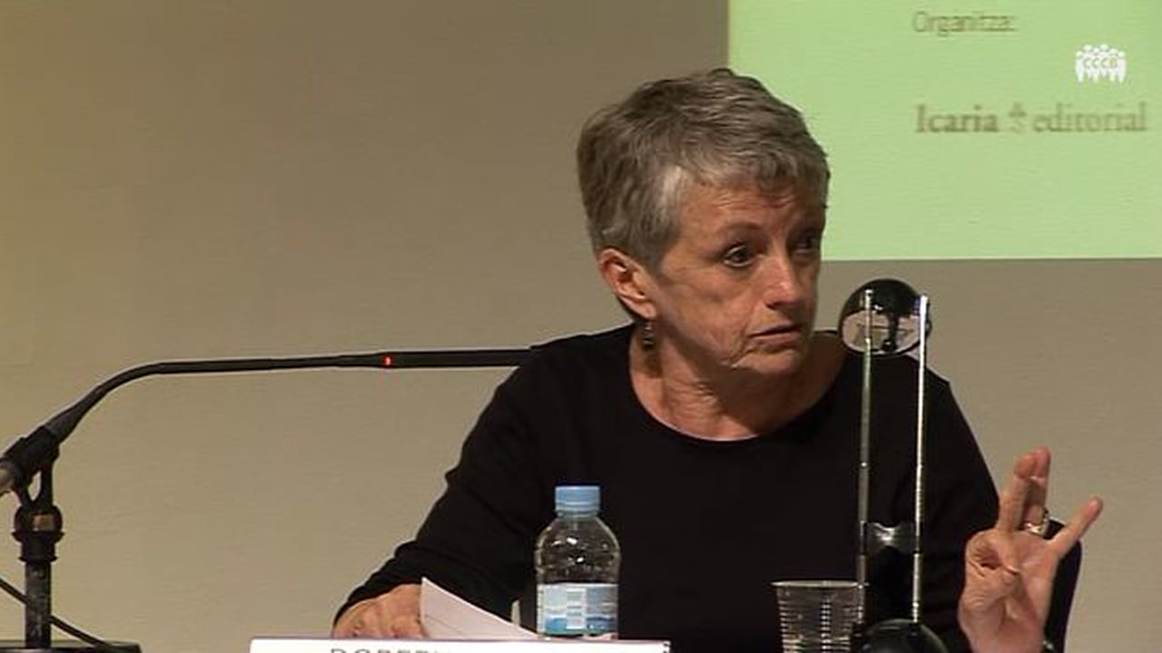
Doreen Massey
3 January 1944 – 11 March 2016

Slide 3

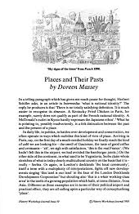

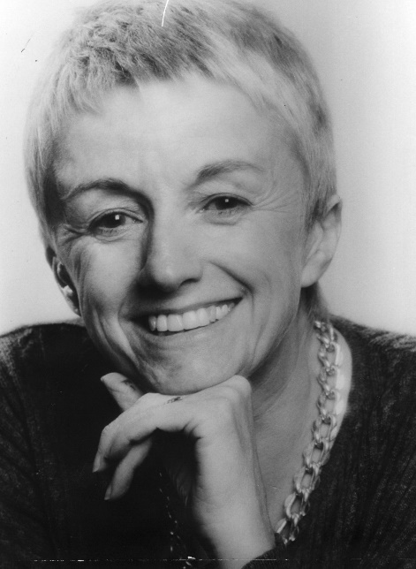

Slide 4
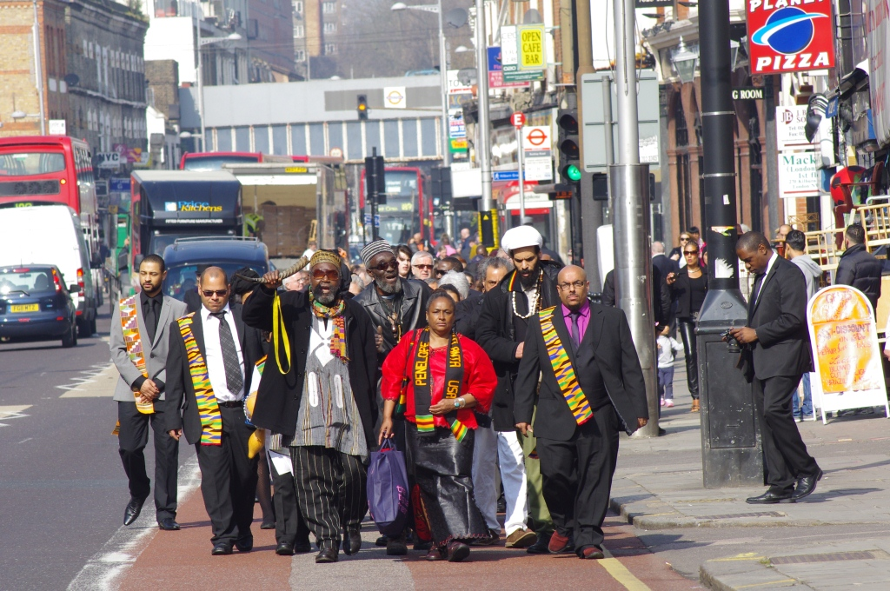
'It is impossible to begin thinking about Kilburn High Road (North London) without bringing into play half the world and a considerable amount of British imperial history’

Slide 5
Reforming A-Level Geography
‘Smith Review’ consultation on revised A-level content (led by Prof Mark E. Smith, Vice Chancellor of Lancaster University) recommended that introduction of new Geography A-level be delayed unto 2016 following further work ‘with key stakeholders and higher education’
ALCAB panel leading on review of content. Our aim was to devise content criteria that awarding bodies can use to develop specifications and Ofqual can use to develop assessment.
Notes:
This time last year we did not know that there would be a major review of the Geography curriculum. It was initially felt that a revision was not needed. However, following consultation with key stakeholders, it was decided in a review conducted by Mark Smith that there should be a proper look at the syllabus and recommendations for change.
ALCAB charged with doing this (more on next slide). Our remit strictly about content and not assessment. Ofqual deal with specifying assessment and a member was present at all our meetings. Tricky to separate content and assessment, but had to.

Slide 6
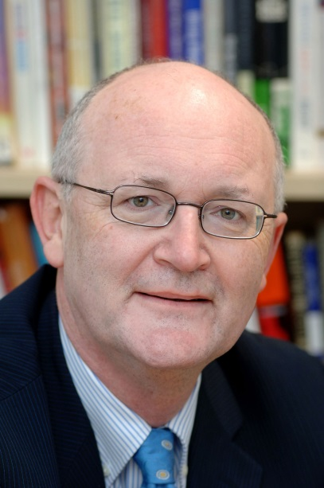
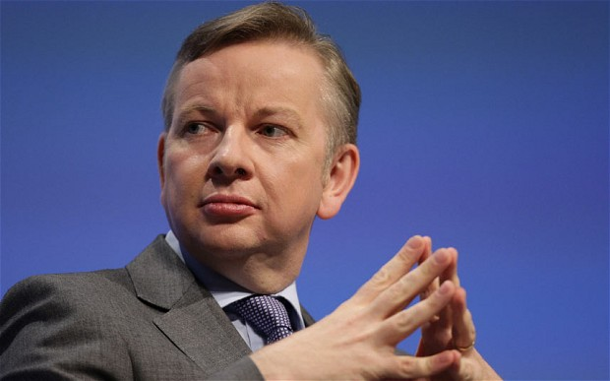
A-Level Content Advisory Boards
Governed by a Management Board which reports to the Russell Group. The Board is currently led by Professor Nigel Thrift, Vice-Chancellor of the University of Warwick (and geographer!)
Up to eight members of academic staff from Russell Group universities; up to four members of academic staff from non-Russell Group universities that offer taught provision in the subject area covered by the panel.
Up to two other members
Notes:
ALCAB – Michael Gove’s idea to have academic from Russell Group universities advising on content. ‘Bringing back academic rigour’. ALCAB led by a board (including the Pincipal here, Simon Gaskell) and chaired by Nigel Thrift VC at Warwick and a geographer.

Slide 7
ALCAB Geography Panel
Professor Martin Evans, University of Manchester, Chair (Physical)
Dr Pippa Chapman, University of Leeds (Physical)
Professor Klaus Dodds, Royal Holloway, University of London (Human)
Professor Richard Harris, University of Bristol (Human)
Professor Anthony Long, University of Durham (Physical)
Dr Emma Mawdsley, University of Cambridge (Human)
Professor Richard Phillips, University of Sheffield (Human)
Ms Bridget Oeppen, Hills Road 6th Form College, Cambridge
Dr Alastair Owens, Queen Mary University of London (Human)
Dr Ruth Weaver, Plymouth University (Physical)
Dr Rita Gardner, Royal Geographical Society
Mr Alan Kinder, Geographical Association
Content criteria writer:
Prof Eleanor Rawling, University of Oxford
Notes:
Panel – process of recruiting. Open call for invitations (not just Russell Group); selection.
Chaired by Martin Evans from Manchester.
Equal balance of human and physical
1 school teacher
GA and RGS
Content criteria writer

Slide 8

Changing place, changing places
Developing understanding of key concept in human geography: ‘place’;
developing expertise and understanding of cultural geography: e.g. relationships between space and identity
Recent thinking about place has emphasised its ‘relational’ nature of place
Places are dynamic, changing over time and fundamentally shaped by their relationships to other places and spaces at a range of scales
E.G. Doreen Massey ‘A global sense of place’
Notes:
End up with further discussion of this theme. Can’t second guess what the AOs will develop, but wanted to flesh out the sorts of issues and questions and topics that this theme might cover.
Place as a key concept
Lots of work on that across human geography

Slide 9
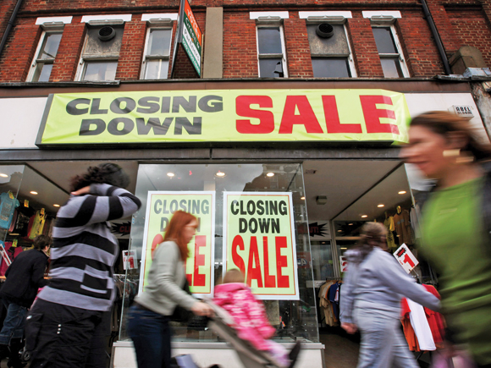
Four core themes:
4) Changing place, changing places
Will require that students undertake study of the way in which relationships, connections, meaning and representation affect continuity and change in the nature of places and our understanding of place.
Choose one of:
  Changing demographic and cultural characteristics
  Economic change and social inequalities
  Food production, circulation and consumption
Notes:
The final theme begins at the more local scale. We want student to think about the idea of place – a key geographical concept. Looking at changing nature of place – what causes places to change (particularly in the context of their relationships with other places and scales) and how people experience and represent that change.
Idea is that student will study the place within which they are studying (or somewhere local) contrasting it within another place or locality (perhaps overseas, and certainly somewhere that is different).

Slide 10
Continued/-
4) Changing place, changing places
And one of:
  Place making and marketing as revealed and contrasted in the work of a range of formal and informal agencies or their materials
  Cultural and artistic approaches to representing place
  Lived experience of place in the past and present
Approach and themes: relationships and connections; scale; change over time; impacts of governments; corporations or international institutions on place; meaning, representation and identity
Skills: qualitative (e.g. understanding meanings and representations of place); quantitative (e.g. geo-spatial data on place characteristics)
Notes:
Then there will be a focus on one of these three themes as a second element to the Changing places core are – looking more at how places are represented and experienced whether that be through marketing and promotion or more cultural and artistic forms of representation. And what about lived experience – how do places matter to people who live their? How is place bound up with people’s sense of identity? Cultural geography here!
Raise questions about how places are shaped by connections to other places, how they shift over time, how they are responsive the activities or national governments, corporations or institutions.
Skills: mix of qualitative and quantitative

Slide 12
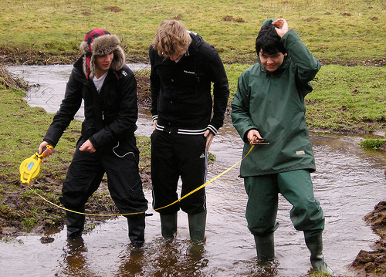
Fieldwork
Minimum 4 days for A level and 2 days for AS level
Must cover human and physical geography
Identify questions; evaluate relevant theory, concepts of literature; devise and implement study methodologies to collect data/information; analysis of data; writing up
NB Some differences between level of demand for AS and A Level
Notes:
Realise some of the challenges here! Not insisting residential. Realise that there is a cost and that can be difficult. However, regard fieldwork as one of geography’s defining and most appealing features. Therefore must have it. Clear statements about its centrality and minimum amount of time to be devoted to it, should help teachers and departments to make the case for and lever in appropriate resource.

Slide 13
Independent Investigation (A level only)
Likely to be linked with fieldwork
Based on a question of issues defined and developed by the student individually
Incorporate field data (can be collected individually or in groups)
Student independently contextualises, analyses and summarises findings and data
Presentation of investigation and its findings via extended piece of writing
Likely to be assessed as teacher marked coursework
Notes:
Tricky theme, but something that we all felt was important and have argued strongly for.

Slide 14
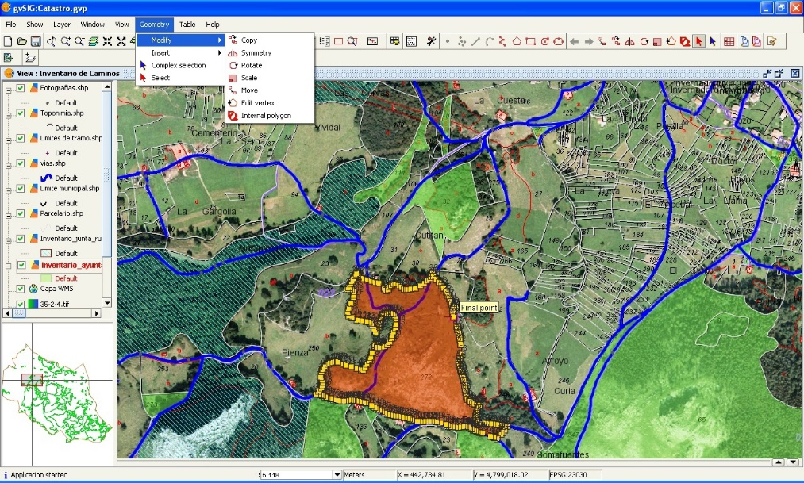
Geographical Skills
Developed in context during study of core and non-core content
Roughly equal balance of quantitative and qualitative
Understand different types of geographical data/information; make critical use of data
How to analyse and interpret different kinds of geographical data/information; communicate and evaluate findings
Qualitative skills – range of approaches including
interviews; textual and visual sources
Quantitative skills – geo-spatial data; understand
GIS and be able ‘to collect and to use digital,
geo-located data’ and understand approaches to
analysing such data; basic descriptive, inferential
and relational statistics
Notes:
Significant development needs here?

Slide 15
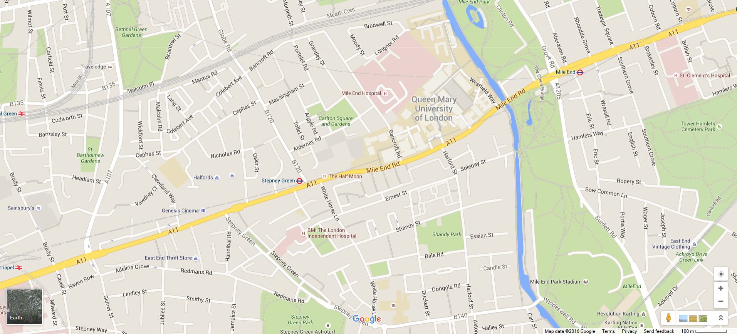
Investigating changing place in East London

Slide 16
Fieldwork for new A Level and GCSE specifications
Investigating changing place using this part of East London as an example
Dr Steven Taylor – doing ‘rigorous’ field investigations in social and cultural geography
Kate Amis – constructing a good field enquiry (example)
2pm Into the field… A guided field walk along the Mile End Road
4pm Back to QMUL – Planning fieldwork enquiries
5pm end

Slide 17
Our aims…
Share ideas and resources for field investigation
Get to know a ‘place’ that offers rich potential for investigation especially for schools and college in East London
Work with one another, developing longer term networks and dialogues around new qualifications

