Slide 1
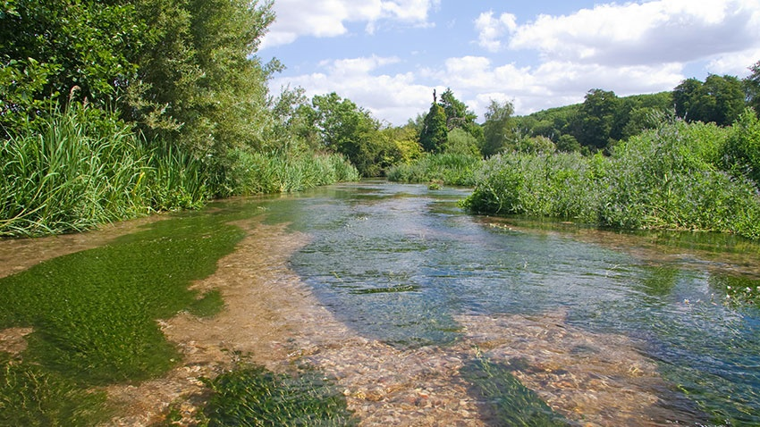
ChessWatch:
Classroom resources
Notes:
Picture credit: Allen Beechey @ Chilterns Chalk Streams Project

Slide 2
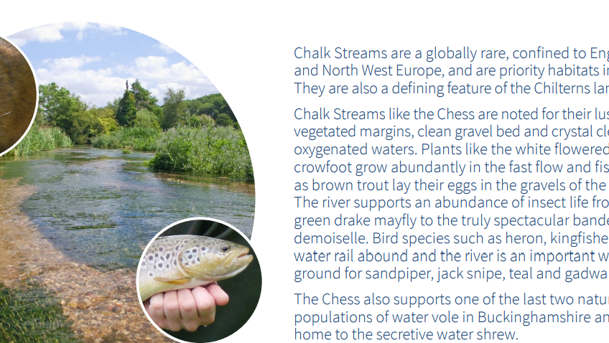

Slide 3
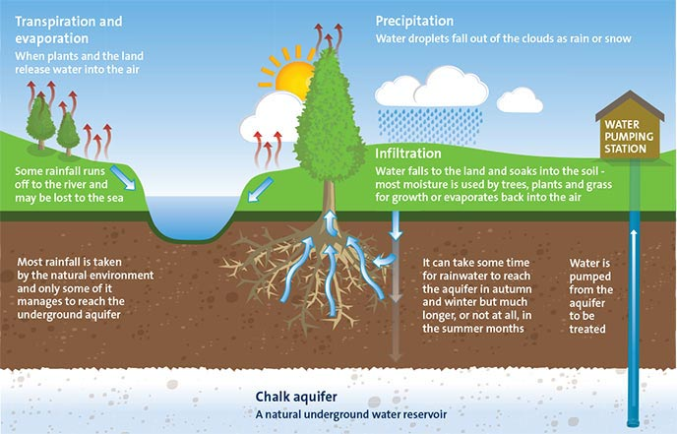
The hydrological cycle in chalk drainage basins
This image is from Affinity Water website: https://www.affinitywater.co.uk/water-cycle.aspx
Notes:
You might want to create another slide of the hydrological cycle in an impermeable catchment to contrast with this slide of the water cycle in a permeable catchment underlain by chalk.
Chalk hydrological cycle - https://www.affinitywater.co.uk/water-cycle.aspx
For an animated version see http://www.riverchessassociation.co.uk/water-cycle.html
This text below from Chilterns Chalk Stream project website :
How do Chalk Streams Work?
Where does the water come from?
Chalk streams are fed from groundwater held in the chalk that makes up the Chiltern Hills, and this gives them some unusual features. Chalk is an aquifer, which means that it is able to soak up and hold water – a bit like a sponge. Water can move through the chalk in cracks called fissures. The water emerges at ground level in the form of springs that feed the chalk streams. Since groundwater levels in the chalk vary according to rainfall and season, chalk streams are naturally intermittent in their flow.
Why do chalk streams sometimes dry up?
During the winter, when rainfall is heavy and able to percolate through the chalk, the aquifer will be well topped up. The head of the stream moves up the valley as the water table rises. In summer, little rainfall percolates into the chalk as it is mostly taken up by plants and lost through evaporation. The water table drops and the head of the stream moves down the valley, leaving the top section of the stream dry. This section is called a ‘winterbourne’ because it only flows after the winter rains.
Winterbourne streams have their own special wildlife which is adapted to cope with intermittent flows

Slide 4
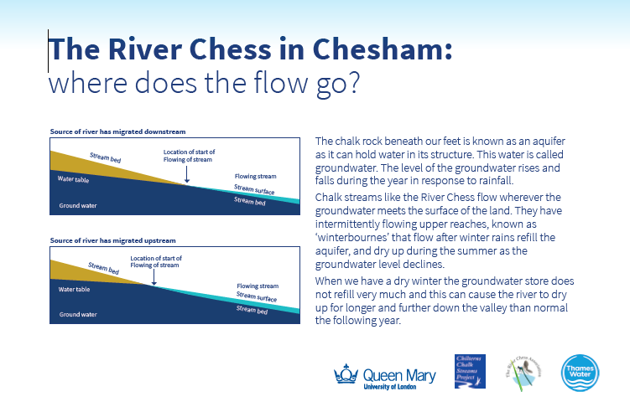
Notes:
Slide diagram from Chesswatch web pages at https://www.qmul.ac.uk/chesswatch/

Slide 5
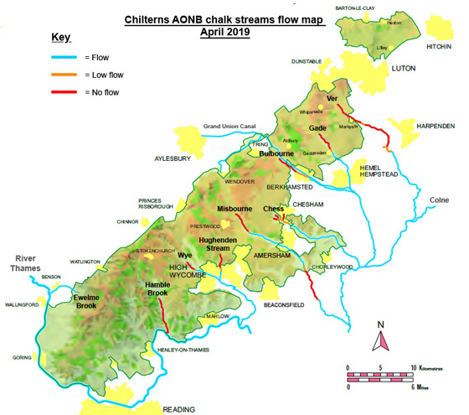
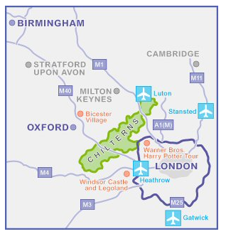
River flows in the Chilterns
https://www.chilternsaonb.org/explore-enjoy/getting-here.html
Notes:
Although chalk streams naturally have winterbourne sections which dry up at certain times of the year, many chalk streams are also seeing increased problems with low flows arising over-abstraction. See this link for information on the state of Chiltern Chalk streams in Spring and Summer 2019. Another question is whether climate change will further alter these flows in the future?
https://www.chilternsaonb.org/news/350/19/River-Groups-call-for-water-restrictions-now-as-drought-conditions-threaten-southern-chalk-streams..html
https://www.chilternsaonb.org/explore-enjoy/getting-here.html

Slide 6
Notes:
This poster is from Chesswatch webpages at https://www.qmul.ac.uk/chesswatch/educational-resources/educational-posters/

Slide 7
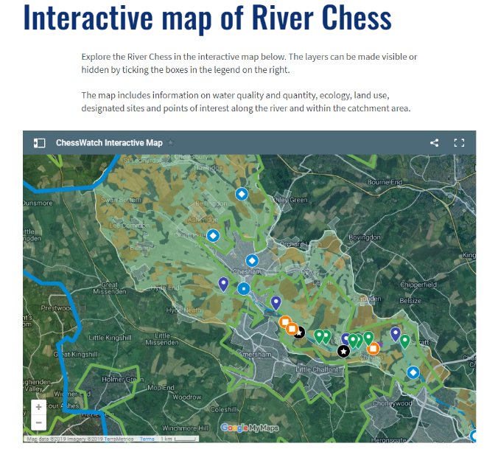
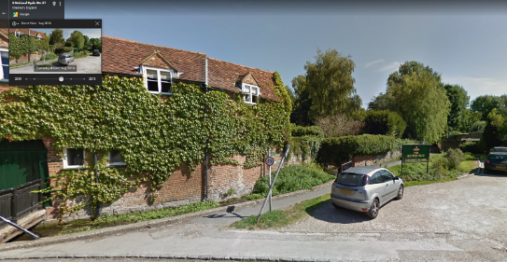
On Googlemaps the date slider bar lets you compare the view over the past 10 years
Notes:
Or use google maps or Google earth to digitally/virtually explore the River Chess
The ChessWatch website has an interactive map for you to explore the River Chess catchment
https://www.qmul.ac.uk/chesswatch/interactive-map-of-river-chess/

Slide 8
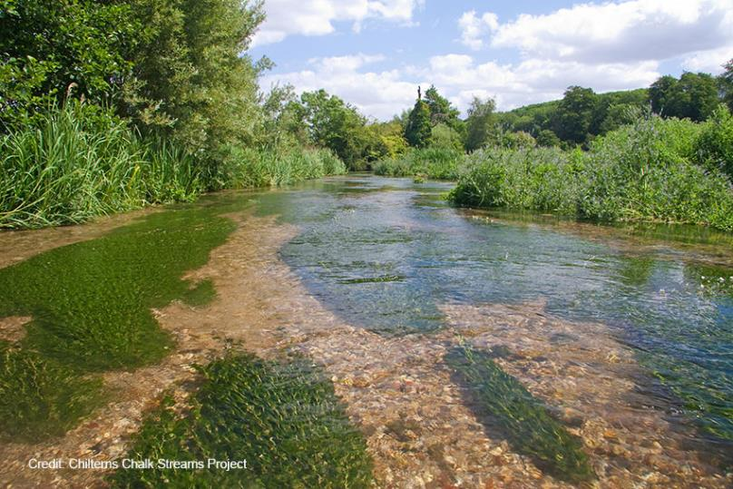
The chalk aquatic ecosystem
What do we look for in an aquatic ecosystem?
Animals
Fish
Insects
Plants
How does each element link and interact as a system?
Notes:
From River Chess Association website :
The River Chess is called a chalk stream because its water comes from the groundwater held in the chalk of the Chiltern Hills. The Chess is fed by springs which form where the water table reaches ground level. The mineral rich water emerges at a constant temperature of about 10°C. The unique character of chalk streams means that they provide a very rich habitat for wildlife, which makes the Chess a great place to come into contact with nature. For example, water voles, which are one of the UK's most endangered mammals, are found in the River Chess.

Slide 9
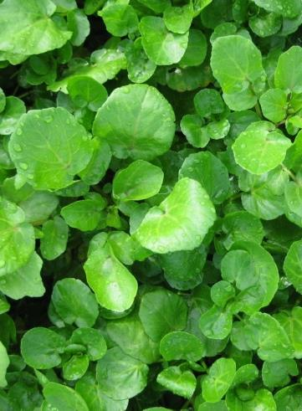
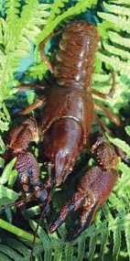
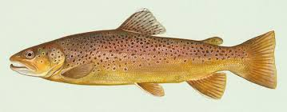
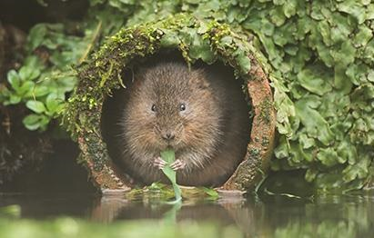
How do these species indicate river health?
Which is the odd one out?
Notes:
Most information here drawn from the River Chess Association website at http://www.riverchessassociation.co.uk
The signal crayfish is the odd one out as it is an invasive species . It creates issues of turbidity by burrowing into the river banks . Signal crayfish (Pacifastacus leniusculus) were introduced from America for the aquaculture industry, but successfully escaped from locations such as the gravel pits in Waterside, Chesham, and made their way into the Chess. Being aggressive and larger they can outcompete the native white-clawed crayfish, but most devastatingly the invaders carry a fungus known as crayfish plague, which is deadly to the white-clawed natives. The last white-clawed crayfish was observed in the Chess in 1996.
Water cress indicates fresh clear water supply usually from an artesian source. Watercress is grown in shallow gravel beds fed by springs and bore-holes, which provide a constant flow of relatively warm, pure, chalk-filtered spring water. Water supply to most “traditional‟ growers is from natural artesian flow from boreholes at the head of chalk rivers.
Trout indicates good quality, oxygen-rich water to thrive and successful breeding depends upon a clean gravel bed for winter spawning. The diet of the brown trout includes invertebrates both on the river bed and those flying near the water's surface. A habitat capable of supporting healthy trout will support a lot more wildlife, including invertebrates, birds and mammals.
Water vole (Arvicola terrestris) is Britain's most endangered mammal, its UK population having declined by 95% in the last 100 years. Water voles live on vegetated river banks and their diet includes watercress and rushes. They can be confused with the brown rat, although water voles have a furry tail and their round ears are largely hidden by their fur. Notoriously shy, water voles are most easily detected by discovering their latrines and by spotting signs of feeding. Find out more about the water vole on the People's Trust for Endangered Species web site.

Slide 10
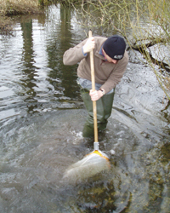
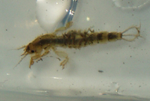
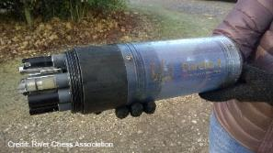
How do we measure the health of a river?
We can measure river health using both chemical and biological indicators
Using water quality monitoring…
Using riverfly monitoring…
pH
Dissolved Oxygen
Turbidity
Water Level
Electrical conductivity
Tryptophan
Chlorophyll -a
Click on each of the indicators to go to the webpage
with further detail about what the sensors are measuring
The River Chess Association has a team of trained volunteers
monitoring fly life on the River Chess:
http://www.riverchessassociation.co.uk/fly-monitoring.html
Notes:
We have installed four sensors into the River Chess. Each sensor will continuously record selected water quality indicators at thirty-minute intervals. This data will be used by the River Chess Association and Chilterns Chalk Streams Project to help them understand the threats to the animals, plants and fish in the river that are caused by human activities in the river catchment.
Click on each of the indicators to go to the webpage with further detail about what the sensors are measuring.
The River Chess Association has a team of trained volunteers monitoring fly life on the River Chess

Slide 11
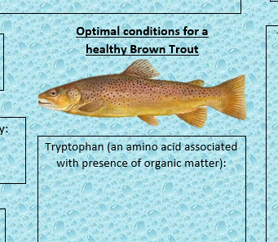
Notes:
You could use this sheet as an activity sheet for your students. The answers appear on the next slide. All the information to answer this is available on the Chesswatch pages here: https://www.qmul.ac.uk/chesswatch/water-quality-sensors/

Slide 12
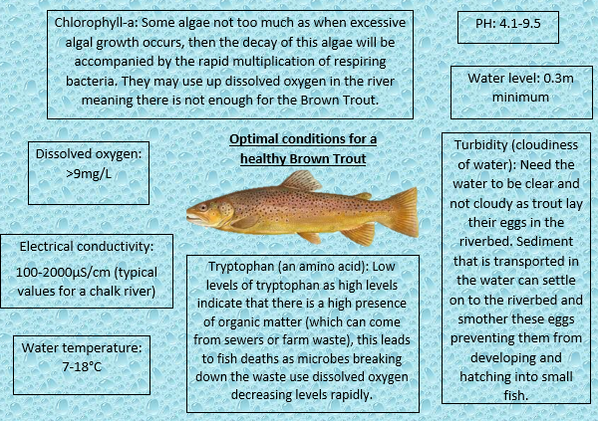
Water quality requirements to support a healthy population of brown trout
It’s not all about water quality. What other factors might you need to support a healthy population of brown trout?
Notes:
Brown trout - https://en.wikipedia.org/wiki/Brown_trout
‘The Environment Agency’s ‘Reason For Failure’ database (2013) was reviewed analysing the data for the failing chalk stream water bodies. It can be incredibly difficult to confirm the Reason for Failure, particularly in relation to diffuse pressures; data on Reasons for Failure was available for three-quarters of chalk stream water bodies. Analysis of the primary Reason for Failure for each chalk stream water body showed the main pressures to be (figures rounded to nearest whole %): • Physical modifications – including barriers to fish passage, urban and rural structures, and land drainage were recorded as the primary reason for failure for 34% of failing chalk streams. • Groundwater and surface water abstraction – 24% • Sewage pollution – 14% • Agricultural pollution caused by run-off of sediment, pesticides, manure and fertilisers – 10% • Urban diffuse pollution – 6% • Invasive species – 2% • Other – 9%.’
From: WWF-UK The State of England’s Chalk Streams - page 31 which can be downloaded at http://assets.wwf.org.uk/downloads/wwf_chalkstreamreport_final_lr.pdf

Slide 13
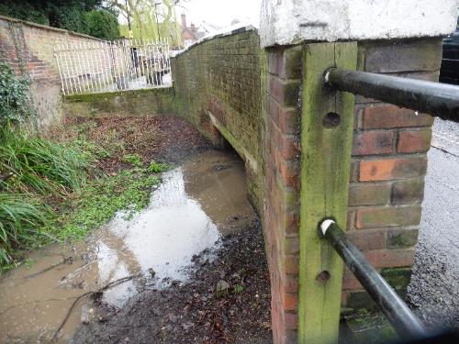
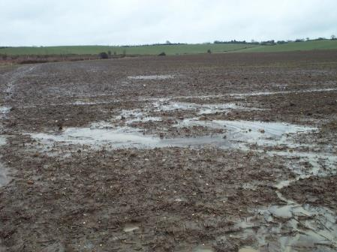
Human disruption to the drainage basin
River channelisation
Abstraction for drinking water
Domestic water use
Agricultural runoff
Notes:
Brainstorm the different human activities that disrupt the drainage basin:
Abstraction
Domestic water use including sewage
Urban growth including urban runoff, flood risk from higher runoff
Roads
Channelling and changes to river course: speeds water movement through drainage basin, reduces friction, increases velocity, impermeable surfaces increase surface water flow and runoff. Potential flood risk downstream
Also:
Industrial pressures: Increased abstraction, chemical pollution, thermal pollution, herbicide and fertiliser pollution

Slide 14
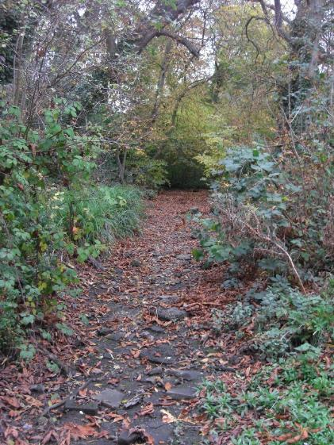
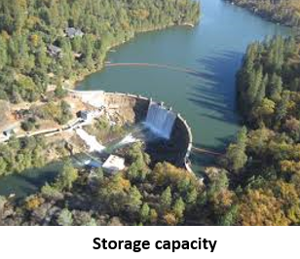
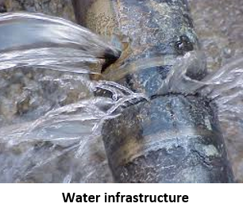
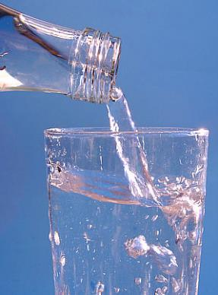
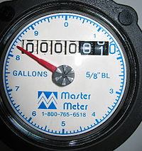
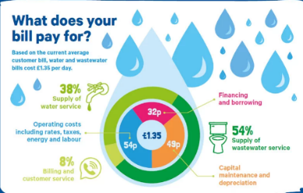
Factors changing water supply and demand
Climate change?
Water use
Water meter
Cost of water (South West water)
Notes:
Notes to assist discussion:
Climate change: see https://www.theriverstrust.org/2019/06/07/river-groups-call-for-water-restrictions-now-as-drought-conditions-threaten-southern-chalk-streams/.
River Chess in Chesham dry 50% of time in past 6 years despite record wet winters in 2012 and 2014. Since then we have had very dry winters. With hotter temperatures more common this drives up demand for water. Hotter temperatures also increases evapotranspiration and makes rainfall less reliable (more storms and less drizzle which increases runoff and decreases aquifer recharge). Coupled with rising population growth and increasing demand for water this creates a crisis situation.
Supply and Demand: See page 4 of https://corporate.thameswater.co.uk/-/media/Site-Content/Your-water-future-2018/WRMP-Glossy.pdf for information about population growth and future water demand in the Thames region. See page 12 for water supply options under consideration (including increasing reservoir storage).
Storage capacity: Plans for future water supply from Thames and Affinity Water include a reservoir storage for water supply. These plans are contested by some public groups. See http://abingdonreservoir.org.uk/index.html for an alternative viewpoint.
Water infrastructure - See page 4 of https://www.nic.org.uk/wp-content/uploads/NIC-Preparing-for-a-Drier-Future-26-April-2018.pdf for a useful infographic. This report looks at creating drought resilience by reducing leakage, reducing demand and improving flexibility of supply by water transfer and increased storage options . All based on significant investment across the water industry.

Slide 15
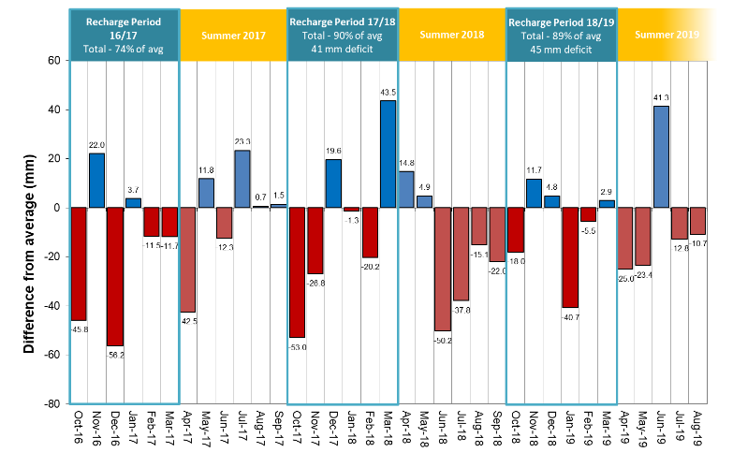
Thames Water Rainfall 2016/7 – 2018/9
https://www.thameswater.co.uk/help-and-advice/water-quality/where-our-water-comes-from/reservoir-levels-and-rainfall-figures
Notes:
Difference in rainfall levels from long term average over last 3 years in the Thames region

Slide 16
Water resources: sustainable long-term planning
Present a plan for sustainable water management in the River Chess catchment which meets the needs
of the present whilst safeguarding the needs of the future
Create a plan that uses the following terms:
Risk | River health | Climate change | Water level
Mitigation | Standard of living and quality of life | Sustainability | Water shortage
Adaptation | Population growth | Resilience | River Health

