Slide 1
Time Management for Study & Life

Slide 2
Learning Outcomes
Study planning
Time and task management
Self-management and motivation

Slide 3
5 Steps to Effective Time Management
Make a Plan
Draft To-do list
Optimise To-do list
Manage your Self
Reward your Self

Slide 4
Reverse planning
Normally you might start planning by figuring out your first steps and working forward.
Reverse planning means starting with the end goal and working backwards.

Slide 5
Reverse planning
Normally you might start planning by figuring out your first steps and working forward.
Reverse planning means starting with the end goal and working backwards.
Take exam

Slide 6
Reverse planning
Normally you might start planning by figuring out your first steps and working forward.
Reverse planning means starting with the end goal and working backwards.
Final review
Take exam

Slide 7
Reverse planning
Normally you might start planning by figuring out your first steps and working forward.
Reverse planning means starting with the end goal and working backwards.
Do practice Tests
Final review
Take exam

Slide 8
Reverse planning
Normally you might start planning by figuring out your first steps and working forward.
Reverse planning means starting with the end goal and working backwards.
Condense notes
Do practice Tests
Final review
Take exam

Slide 9
Reverse planning
Normally you might start planning by figuring out your first steps and working forward.
Reverse planning means starting with the end goal and working backwards.
Create study plan
Do practice Tests
Final review
Condense notes
Take exam

Slide 10
Reverse planning
Normally you might start planning by figuring out your first steps and working forward.
Reverse planning means starting with the end goal and working backwards.
Create study plan
Do practice Tests
Final review
Condense notes
Take exam
Start studying

Slide 11
Reverse planning
Normally you might start planning by figuring out your first steps and working forward.
Reverse planning means starting with the end goal and working backwards.
Now you have a plan!
1. Create study plan | 2. Condense notes | 3. Do practice questions | 4. Final review | 5. Take exam

Slide 12
Free reverse planner!
GOAL
DUE:
STEP 5
DUE:
STEP 4
DUE:
STEP 3
DUE:
STEP 2
DUE:
STEP 1
DUE:

Slide 13
Drafting a To-Do List
To-do List
1. Revise Earth Surface Science
What is wrong with this to-do list?

Slide 14
Drafting a To-Do List
To-do List
1. Revise Earth Surface Science
What is wrong with this to-do list?
How many tasks is this really?
How do I know how much time it will ?
When do I take a break?

Slide 15
Drafting a To-Do List
To-do List: Revise Earth Surface Science (ESS)
1. Divide ESS topics into major (core) and minor. Focus on core topics first
2. Condense notes into question and answer format
3. Do practice test
4. Review incorrect answers in notes
5. Repeat 2-4 for minor topics
6. Map links between all topics.
7. Do practice test for whole topic
Better!
Unpack your overall task into smaller tasks.
Now you know you can’t do all of this just before an exam.
Add timings and breaks

Slide 16
Optimizing your To-do List
To make your to-do list more effective, do three things:
Prioritize
Timebox
Monitor progress

Slide 17
Optimizing your To-do List: Prioritize
Apart from study, write down everything you need to do. Include:
Leisure time
Family time
Errands
Communications

Slide 18
Priority = Important x Urgent
Important
For each task first think how important it is: :
How strongly is it related to my main (study) goals?
How strongly is it related to my health and wellbeing?
Not
important

Slide 19
Priority = Important x Urgent
For each task think how urgent it is: :
How soon is the deadline?
How flexible is the deadline?
Urgent
Not Urgent (yet!)

Slide 20
Priority = Important x Urgent
Important
Arrange all your to-do list tasks into an Eisenhower Priority Matrix.
Urgent
Not Urgent (yet!)
Not
important

Slide 21
Priority = Important x Urgent
Box 1: You should do these things immediately!
Important
1
JUST DO IT!
Urgent
Not Urgent (yet!)
Not
important

Slide 22
Priority = Important x Urgent
Box 1: You should do these things immediately!
Box 2: You should plan how and when you will do it - and put it in your schedule.
Important
1
2
JUST DO IT!
PLAN:
Urgent
Not Urgent (yet!)
Not
important

Slide 23
Priority = Important x Urgent
Box 1: You should do these things immediately!
Box 2: You should plan how and when you will do it - and put it in your schedule.
Box 3: These activities you can ask somebody to help you do e.g. friends, family, university advice and support.
Important
1
2
JUST DO IT!
PLAN:
3
Not Urgent (yet!)
Urgent
GET SUPPORT.
Not
important

Slide 24
Priority = Important x Urgent
Box 1: You should do these things immediately!
Box 2: You should plan how and when you will do it - and put it in your schedule.
Box 3: These activities you can ask somebody to help you do e.g. friends, family, university advice and support.
Box 4. Do these things in a break or to reward yourself after you've finished a task!
Important
1
2
JUST DO IT!
PLAN:
3
4
Not Urgent (yet!)
Urgent
GET SUPPORT
REWARD SELF:
Not
important

Slide 25
Share, Compare, Get Feedback.
Fill in your Priority Matrix and share it with your classmates.
You can improve your own ability to prioritize by comparing with others in a similar situation.
You can also send your Priority Matrix for feedback to the Academic Skills team at QM Library. Chat Live through Microsoft Teams:
Important
1
2
JUST DO IT!
PLAN:
3
4
Not Urgent (yet!)
Urgent
GET SUPPORT
REWARD SELF:
Not
important

Slide 26
Optimizing your to-do List: Timeboxing
Switch from task to time-based thinking.
Allocate a length of time to each task on your To-Do list
Choose one task to do
Launch the timer
Do the task for the set time and then move on to next task.
Reschedule any unfinished task

Slide 27
Optimizing your to-do List: Timeboxing
Switch from task to time-based thinking.
Allocate a length of time to each task on your To-Do list
Choose one task to do
Launch the timer
Do the task for the set time and then move on to next task.
Reschedule any unfinished task
Task-based thinking
Time-based thinking
FINISH TASK
START 9AM

Slide 28
Optimizing your to-do List: Timeboxing
Switch from task to time-based thinking.
Allocate a length of time to each task on your To-Do list
Choose one task to do
Launch the timer
Do the task for the set time and then move on to next task.
Reschedule any unfinished task
Task-based thinking
Time-based thinking
FINISH TASK
START 9AM
START 9AM
FINISH 11AM
NEXT TASK

Slide 29
Optimizing your to-do List: Timeboxing
Advantages of time-based thinking
Stops procrastination and perfectionism
Helps you switch between and study a few topics together – better for making connections and learning
Helps you focus on key points rather than details
Helps you better estimate how long tasks take

Slide 30
Optimizing your To-do List: Monitor Progress
Add a 'Doing list and a Done list to your To-do list!

Slide 31
Optimizing your To-do List: Monitor Progress
Add a 'Doing list and a Done list to your To-do list!
Monitor the progress of your tasks on a Kanban Board
Kanban is a workflow management tool originally used in manufacturing and software development.
The method is increasingly popular as a tool for professional development and personal improvement.

Slide 32
Optimizing your To-do List: Monitor Progress
Monitor the progress of your tasks on a Kanban Board
You likely have a few items on your to-do list and you can't always do them one by one
Switching between tasks and topic can be good:
More motivating (mix tasks you like more with tasks you like less).
More effective for revision as it helps connect topics.

Slide 33
Optimizing your To-do List: Monitor Progress
Monitor the progress of your tasks on a Kanban Board
Switching between tasks and topic can be good:
More motivating (mix tasks you like more with tasks you like less).
More effective for revision as it helps connect topics.
And it's rewarding to see your tasks move across the board!

Slide 34
Self-Management: Use Procrastination!

Slide 35
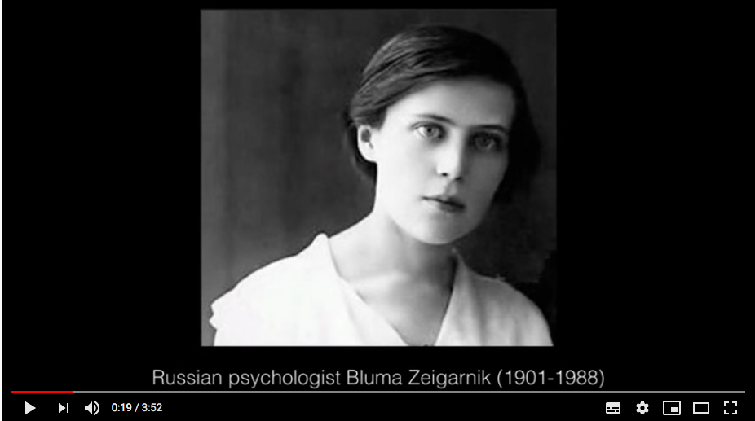
Self-Management: Use Procrastination!
Zeigarnik effect – unfinished tasks are remembered better than finished tasks.
Always make a start on a task
Take a (strategic) break before you finish
Check Instagram, tidy up, raid the fridge, watch a Netflix episode…
Return to the task
Using the Zeigarnik Effect for active procrastination: watch video

Slide 36
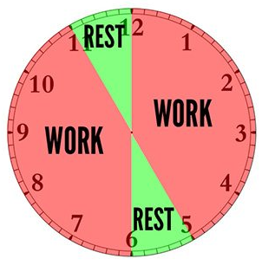
Self-Management: Breaks and Rewards!
Work in ‘Pomodoros’
Study in short bursts with regular breaks
Decide on length of study bursts and breaks.
Classic Pomodoro = 25 minutes study/5 minutes breaks
45/15 is a common alternative.
Click for video

Slide 37
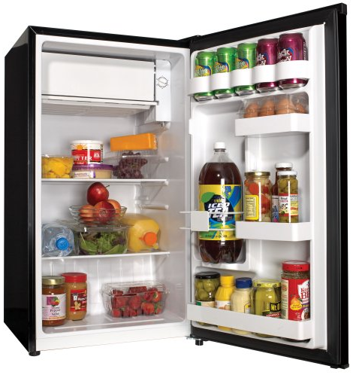
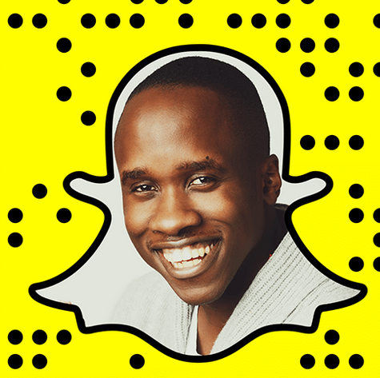
Breaks and Rewards
Choose what to do in your breaks.
Urgent but not important tasks
Fun stuff
Get study tips from Queen Mary Library Academic Skills Team

Slide 38
Self-management: Anti-distraction Apps!
Phone apps are distracting. But…

Slide 39
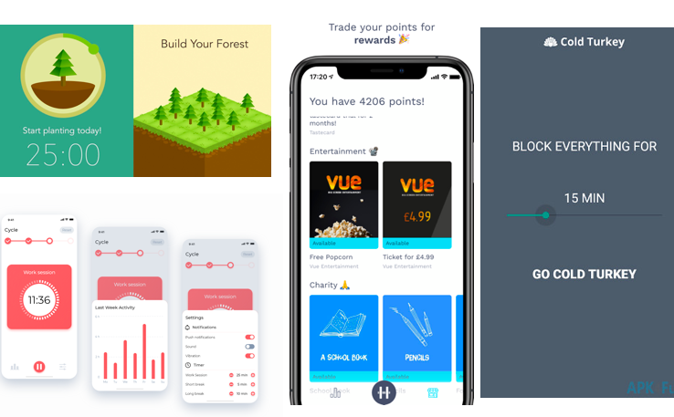
Self-management: Anti-distraction Apps!
There are several apps that can help you to both organise your study.
Because these apps are fun they can also motivate you to study.
But best of all, these apps can also be used to stop distractions

Slide 40
Four of the best study management apps
Forest | Phone app blocker that gamifies your work schedule | Video explainer
Cold Turkey | Desktop website blocker with built-in timers | Video explainer
Hold | Incentives and rewards for not using your phone! | Video explainer
And last but definitely not least, Pomotodo | Supports the Pomodoro time management technique | Video explainer

Slide 41
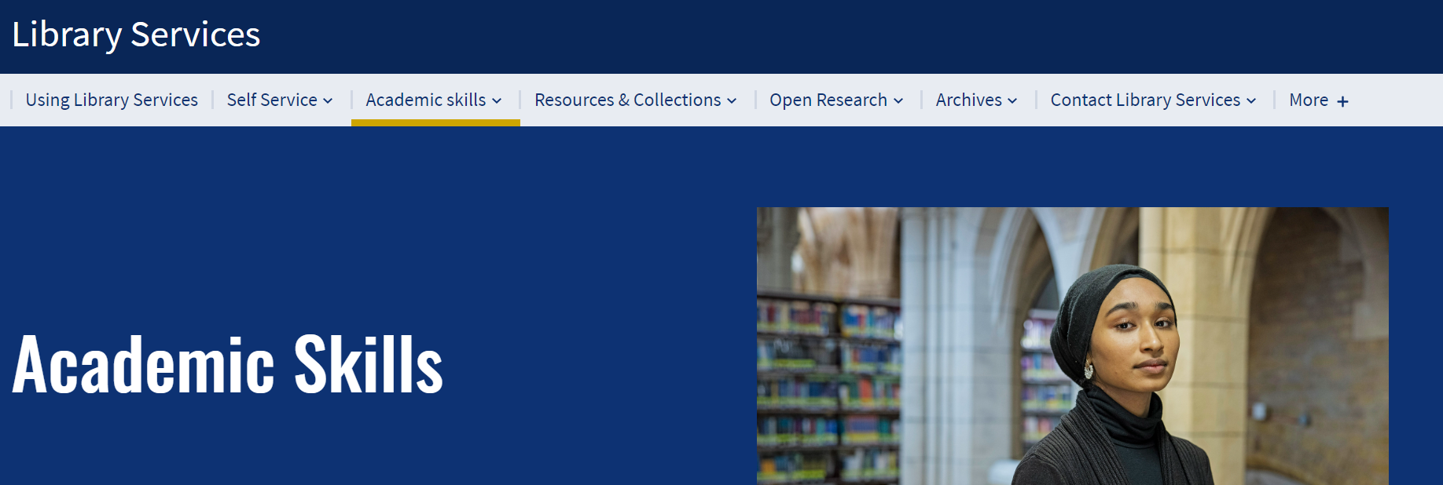
More tips
To find more resources, access workshops and one-to-one support, visit: Academic skills - Library Services (qmul.ac.uk)

Slide 42
End slide

