Slide 1
The Literature Review

Slide 2
Learning Outcomes
Understand what a Literature Review is and why it is written
Know where to look for literature
Know how to manage your literature
Understand how to critically evaluate your literature

Slide 3
What is a Literature Review?
A Literature Review is a piece of academic writing that critically evaluates material relevant to the research project in hand (such as a dissertation, PhD or journal article). It demonstrates subject knowledge and an understanding of the author’s position in relation to other academic work.

Slide 4
What is a Literature Review?
A Literature Review often appears at the beginning of a piece of academic writing, but not always.
A Literature Review may be incorporated into other chapters, such as an Introduction.
You may not need to do a separate Literature Review but evaluate the research of others throughout your work.

Slide 5
Why Write a Literature Review?
It demonstrates to your reader that you have a good understanding of the topic you are discussing.
01
It demonstrates that you know how to critically evaluate other academic work.
02
It demonstrates that you understand how your work relates to other academic research.
03

Slide 6
How is it different to an Introduction or Background?
Introductions and Background sections provide the reader with knowledge they may need in order to understand what comes next.
A Literature Review helps the reader to understand how your work fits into the wider academic conversation about the topic.

Slide 7
Choose Your Literature Carefully
Literature Reviews begin with the choosing of your literature. Don’t just include everything that you read on the topic.
Decide on your parameters – what will you include and what will you leave out?
Include the most important texts.
Include the most relevant texts.

Slide 8
Finding Your Literature
Your subject reading lists are a good place to start, but don’t stop there.
Look at the bibliographies of the articles and books you have already read.

Slide 9
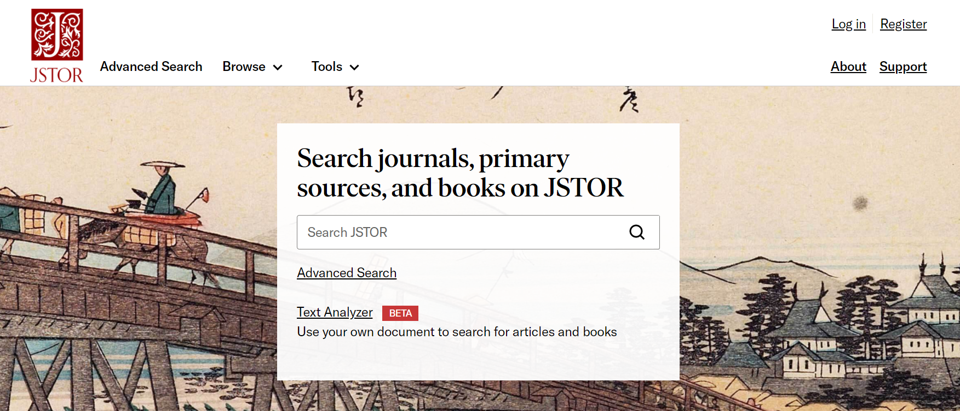
Finding Literature
Search on jstor.org for articles

Slide 10
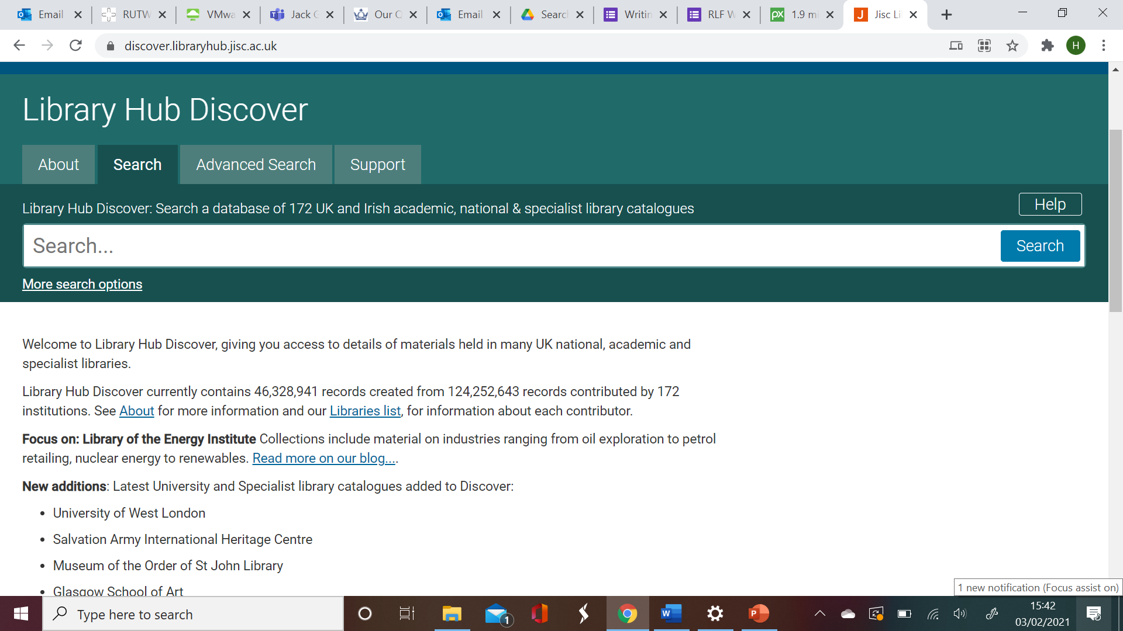
Finding Literature
Use Library Hub Discover to see what other university libraries have.
Students can use interlibrary loans to get literature from other libraries: Get it for me - Library Services (qmul.ac.uk)

Slide 11
Finding Literature: SCONUL ACCESS SCHEME
Queen Mary students can register for the Society of College, National and University Libraries (SCONUL) access scheme. This scheme allows students and staff studying and researching within Higher Education in the UK access to over 170 academic institution libraries.
https://www.qmul.ac.uk/library/using-library-services/visiting-/sconul-access-for-queen-mary-staff-and-students/

Slide 12
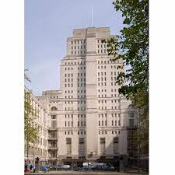
Finding Literature
Senate House
Wide selection of literature for arts, humanities and social science.
British Library
Has over 170 million items including books, newspapers, journals, maps, sound recordings and more.

Slide 13
Finding Literature: Faculty Liaison Librarians
Each faculty has a Liaison Librarian who can help you to find the information you need and learn how to use it:
HSS - library-hss@qmul.ac.uk
SMD - library-smd@qmul.ac.uk
S&E - library-sande@qmul.ac.uk

Slide 14
Critically Evaluate
You need to evaluate the literature, not just report what it says.
One way to make sure you do this is to ask questions of the text.

Slide 15
Examples of Questions
When was the work written and is that relevant?
Who wrote it and is that relevant?
What are their sources?
Is their conclusion justified? Is it supported by the evidence?
What are the flaws in their work? What are the positives?
Does the author support a certain theory, method or school of thought?
How does the work fit in with other literature? (I.e. does it support what others have said or argue against others?).

Slide 16
Managing Your Sources
You will be reading a lot, so you want to make sure you don’t forget things. If you have a good technique for making notes, it will make it a lot easier when it comes to writing your literature review.
One technique for keeping good notes is to use a system like Cornell Notes. This involves dividing your page into four parts: bibliographical details, notes, questions and summary.

Slide 17
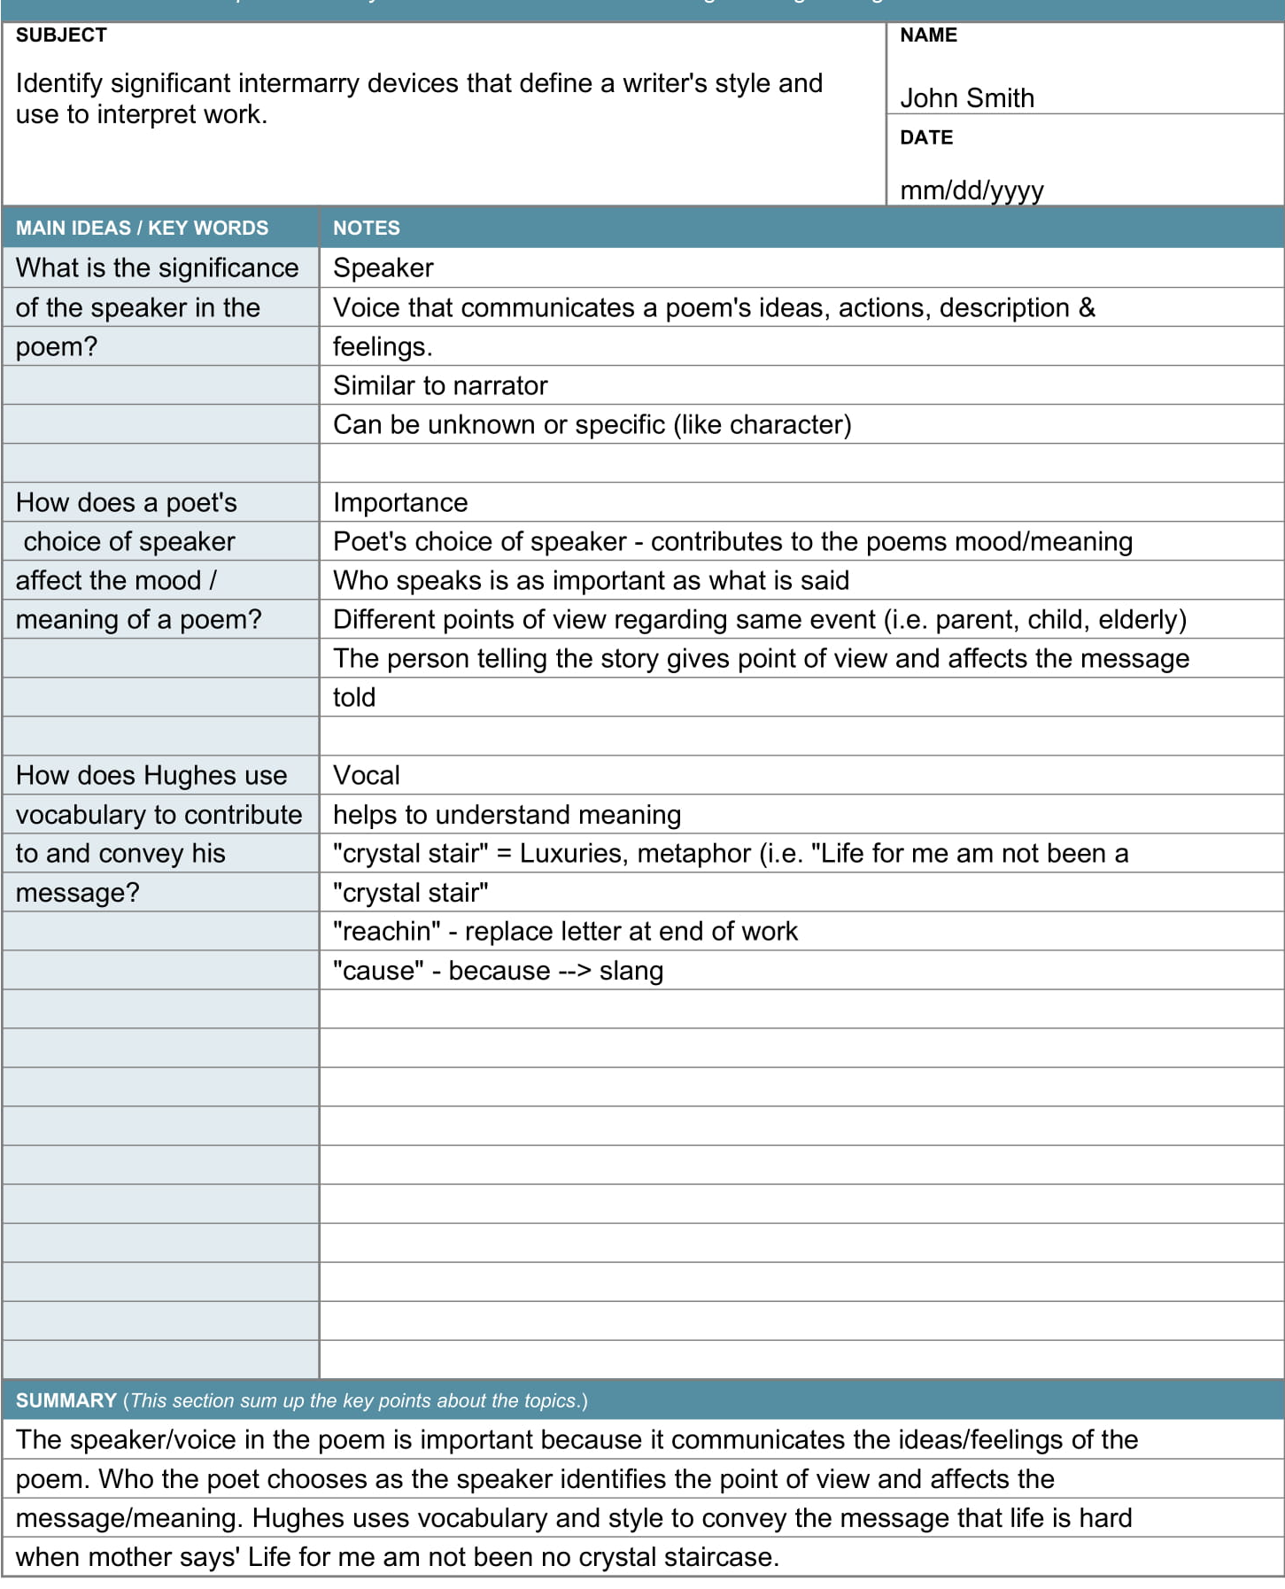
Cornell Notes
Bibliographical details (author, date etc).
Ideas or questions that arise as you read the text.
Notes that you make on the text.
Summary of the text and your thoughts on it.

Slide 18
Cornell Notes
Using a system like Cornell Notes has many benefits. It limits the amount of notes you take so you don’t end up just coping long bits of text. It also encourages you to think about the questions you have on the text.
And when you come to writing your literature review, you can just refer to your Cornell Notes, rather than searching through pages and pages of writing.

Slide 19
Writing Your Literature Review
Like any piece of academic writing, plan how you are going to structure your literature review. By theme? By limitations? Chronologically?
Remember, a literature review is not a book review. You should not only tell us what the literature says and what you think about it, but how this relates to your research.

Slide 20
Writing Your Literature Review
If you have many texts that say similar things, use exemplars:
‘This pattern has been noted by many researchers including, for example, Jackson et al, who found that…’
Point out the gaps in the literature:
‘While much has been written on childhood and teenage obesity (for example, Hobbs 2016, Shuster et al 2017, Claridge et al 2020) little research has been conducted on obesity in young adults.’

Slide 21
Writing Your Literature Review
Tell the reader how your work will fill in the gaps:
‘Although the conclusion of Luke and Simmons was compelling, their research has limited application since they only surveyed young men. This study will aim to question both young men and women.’
Where appropriate, tell the reader what you will not be including in your literature review:
‘While the causes of the Russian Revolution are often debated, it is beyond the scope of this work to discuss them.’

Slide 22
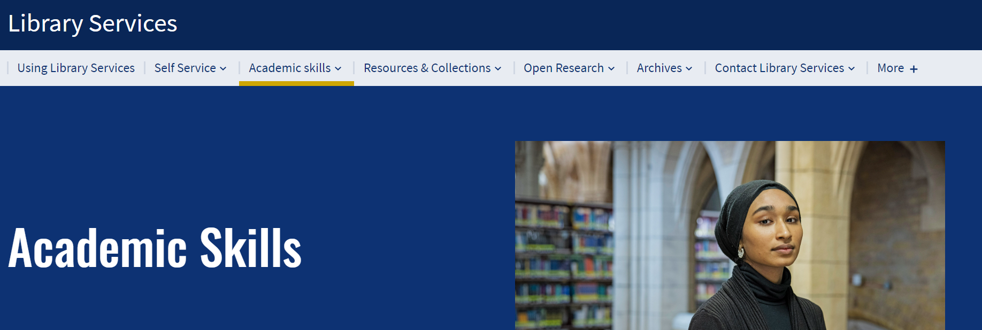
More tips
To find more resources, access workshops and one-to-one support, visit: Academic skills - Library Services (qmul.ac.uk)

Slide 23
End slide

