Slide 1
Being critical in your academic work

Slide 2
Learning Outcomes
Understand what it means to write critically
Apply higher-order critical skills to your own writing
Evaluate your work and the work of others using different types of questioning prompts.

Slide 3
“Be critical”
Academic tutors often tell students to “be more critical” in their writing. Or to “be less descriptive.”
But often they don’t have the time in their feedback to explain what that means.
This guide will explore the difference between critical and descriptive writing and will give you some strategies for being more critical in your work.

Slide 4
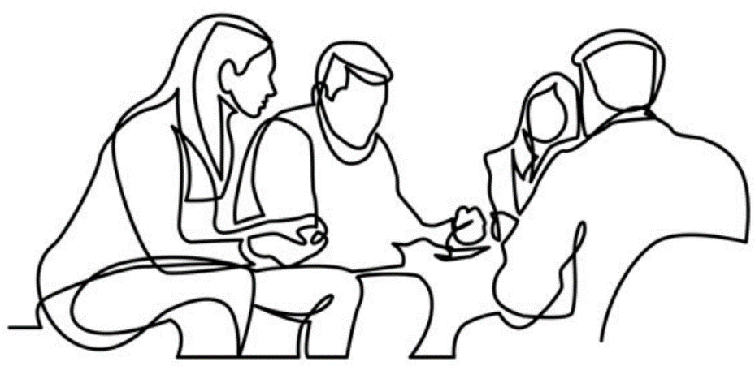
“A conversation among scholars”
...
Think of your discipline as a conversation among scholars.
By reading what other scholars before you have written on a subject, you are listening along to that conversation.
You'll use your existing knowledge to understand what's being said and analyse the different perspectives.

Slide 5
“A conversation among scholars”
When it’s your turn to speak, it’s good to refer to what other scholars have already said. But you don’t want to just repeat it.
Instead, you want to try to build on it to make a point of your own.
This is what is meant by “being critical.”

Slide 6
Higher-order skills
You’ll find clues as to what this means in practice by looking at the mark schemes for your modules.
You’ll notice that the descriptions of highly-graded work include verbs like appraise, discriminate, analyse, apply.

Slide 7
Bloom’s Taxonomy
These terms relate to what educational psychologists call higher-order thinking skills.
These are skills that allow you to contribute to the conversation in your discipline in more creative and original ways.
Bloom’s taxonomy shows these skills in a hierarchy, with more critical skills at the top.

Slide 8
Bloom’s Taxonomy

Slide 9
Bloom’s Taxonomy
Critical writing demonstrates your ability to carry-out these higher-order critical skills by...
Creating your own theoretical framework.
Evaluating other scholars’ work.
Analysing their evidence or logic.
Descriptive writing demonstrates your understanding of a subject by showing that you are able to recap the main points.

Slide 10
Not just “criticising”
So what does critical writing look like in practice? It’s not just about “criticising” other authors. You can be critical by...
- Putting their work into a wider context.
- Making evaluative observations about what they choose to emphasise, the concepts that they use and their methodology.
- Comparing and contrasting their work with that of other authors.

Slide 11
Not just “criticising”
So what does critical writing look like in practice? It’s not just about “criticising” other authors. You can be critical by...
- Putting their work into a wider context.
- Making evaluative observations about what they choose to emphasise, the concepts that they use and their methodology.
- Comparing and contrasting their work with that of other authors.
Let’s look at some examples of descriptive and critical writing...

Slide 12
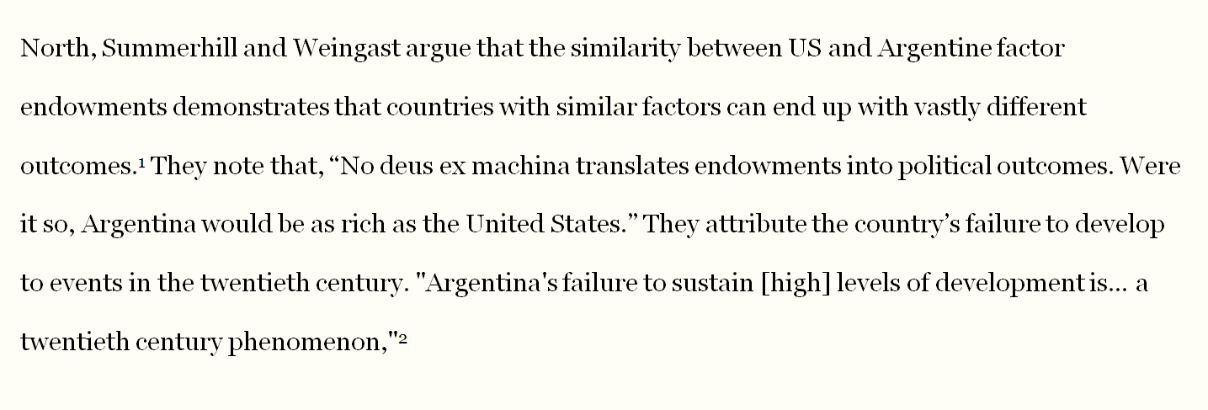
Descriptive writing
Narrates an author’s argument
Often focuses on analysing one reading per paragraph

Slide 13
Descriptive writing
Tends to use long quotes which could be paraphrased
Introduces quotes without criticising/relating to author’s own argument

Slide 14
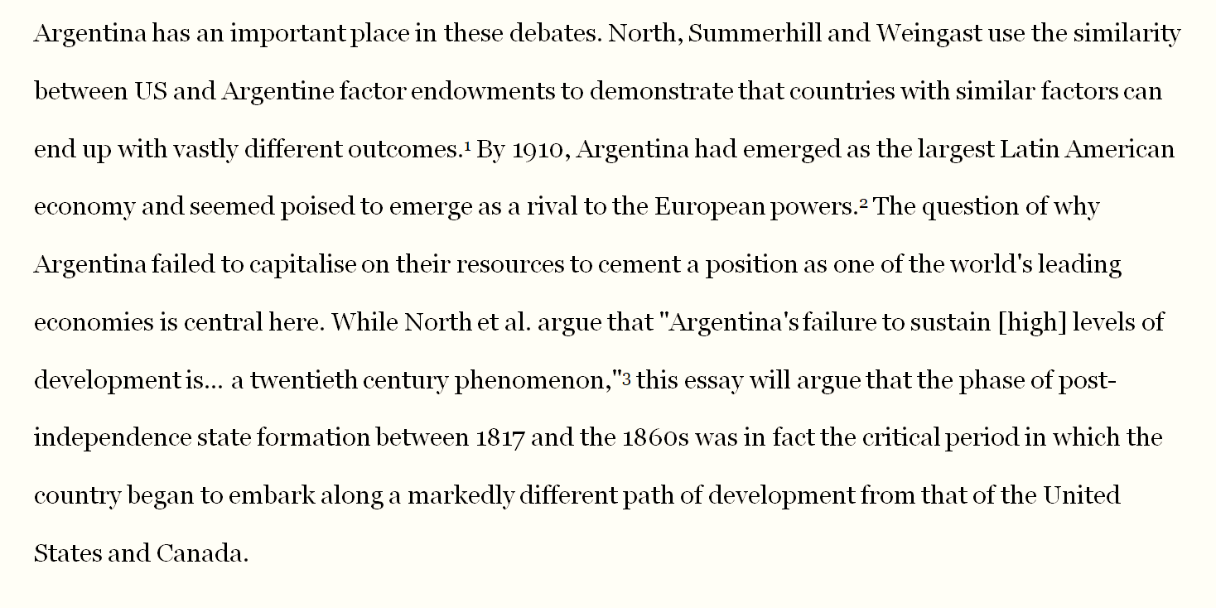
Critical writing
Uses topic sentences that relate content of paragraph to over-all question
Introduces quotes to highlight points of agreement/disagreement

Slide 15
Critical writing
Paraphrases instead of quoting where possible
Uses questions as rhetorical device to guide reader’s attention

Slide 16
Critical writing
Integrates a variety of sources and the author’s own thoughts in the same paragraph
Uses thesis statements to clarify argument

Slide 17
Write with a purpose
The main trick to writing critically is to always relate your discussion back to your argument.
Having this purpose in mind when you plan your writing can help you avoid getting carried away by describing what another author has said.

Slide 18
Tip: Ask yourself questions
One good way to stay critical in your work is to get into the habit of asking yourself questions.
Especially evaluative questions that prompt you to clarify the implications of what you’re reading or writing.
Like, “why am I saying this?” Or “how does this relate to the question?”

Slide 19
Different ways of questioning: Comprehension
When we learn about a new subject, the first types of questions we ask are basic comprehension questions.
What is this text about?
Who is writing this text?
What is the author saying?

Slide 20
Different ways of questioning: Analytical
Beyond that, analytical questions prompt us to connect pieces of information and analyse them as we’re reading.
How do all the parts of this text fit together?
Why has the writer chosen this framework?
Is all of this information correct?

Slide 21
Different ways of questioning: Evaluative
Finally, evaluative questions prompt us to think about the wider significance of a text.
What are the implications of this?
What can be learnt from this?
So what?

Slide 22
Conclusion
Much of “being critical” is about getting into the habit of asking questions like this – especially evaluative questions.
By asking those questions while you’re readings and writing, you’ll find that you are producing more critical work — work that adds something to the conversation in your field.

Slide 23
More tips:
To find more resources, access workshops and one-to-one support, visit: http://qmul.ac.uk/library/academic-skills

Slide 24
End slide

